Slide 1
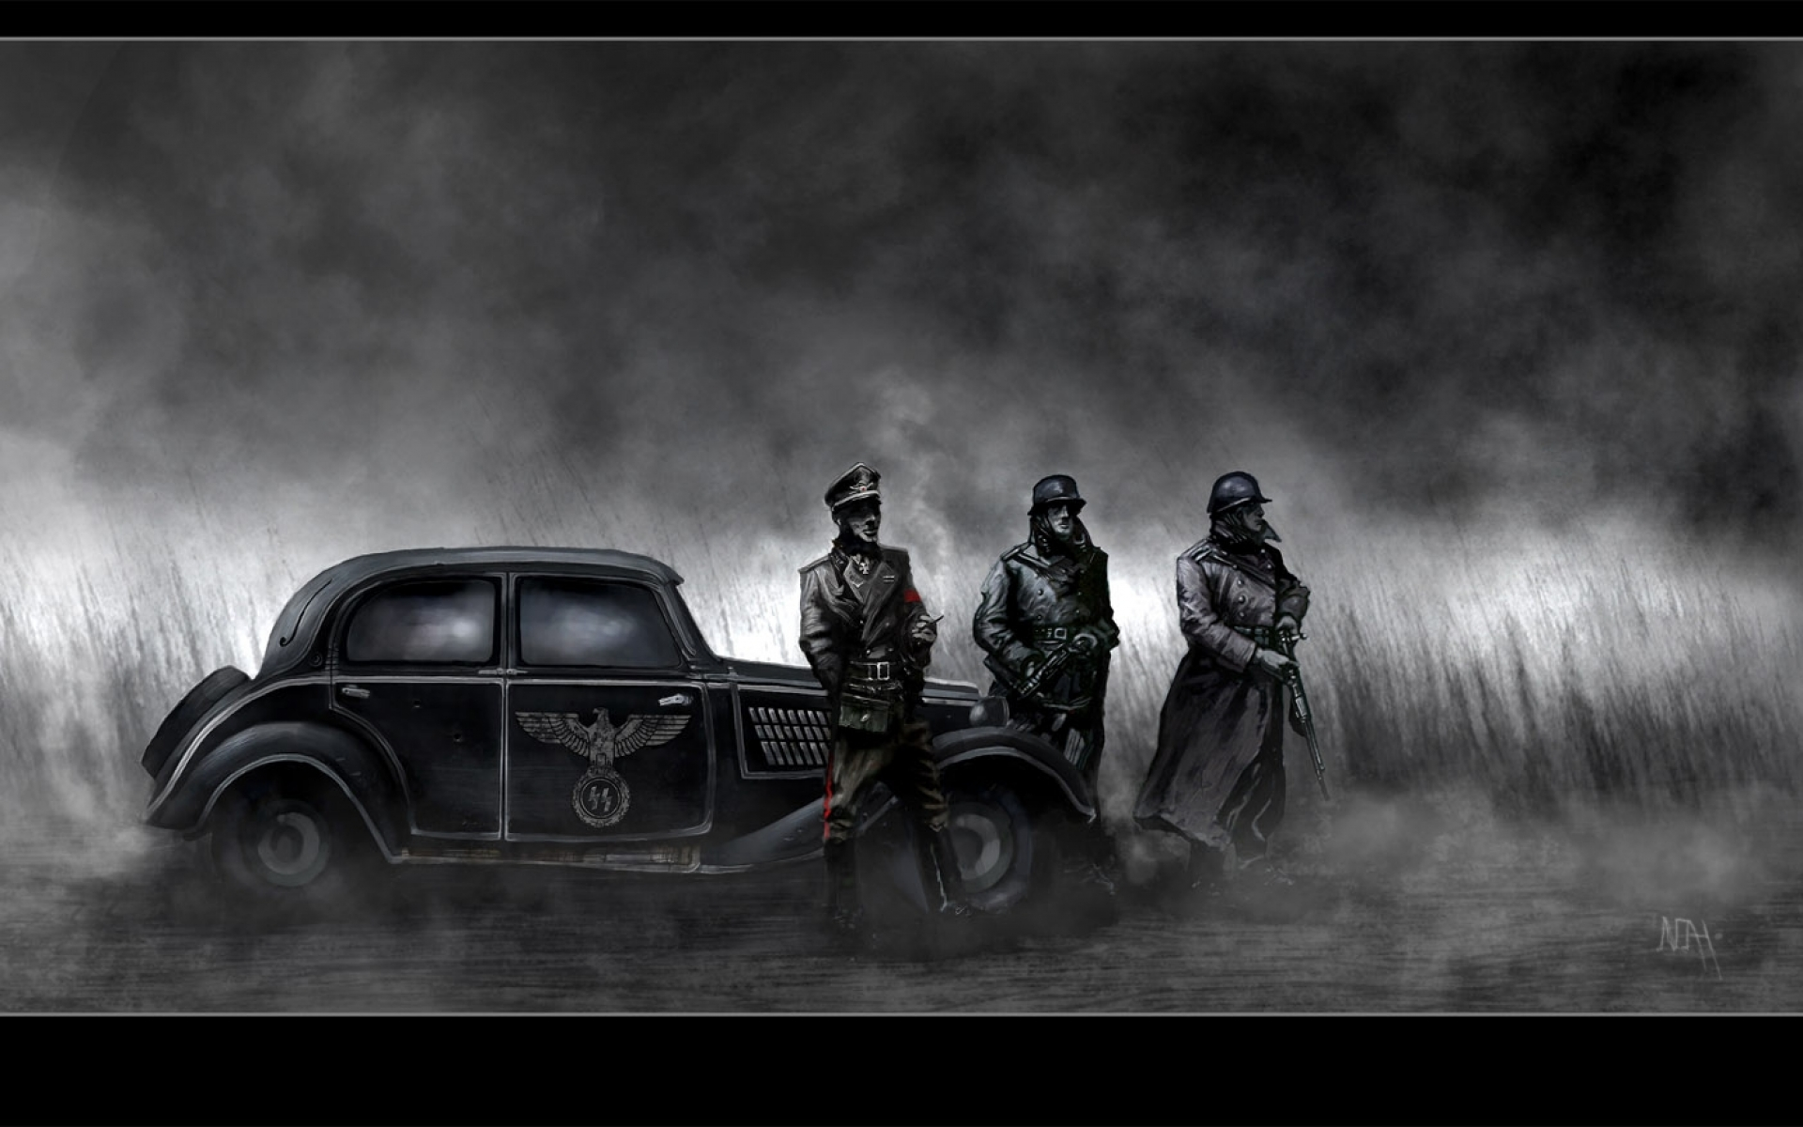
The Holocaust
Vanessa Tokić, Lana Antolović, Lea Jonjić, Matej Mijatović, 1.b

Slide 2
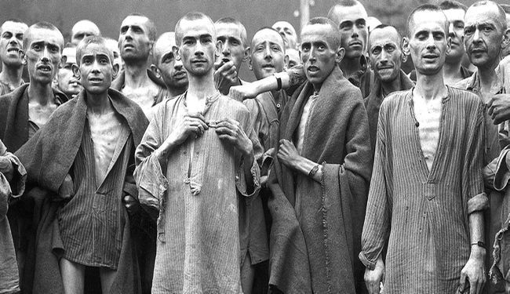
Holocaust
January 27 is International Holocaust Remembrance Day
The Holocaust is the name for the persecution of the Jews.
The word Holocaust is of Greek origin (olokauston-completely burned).

Slide 3
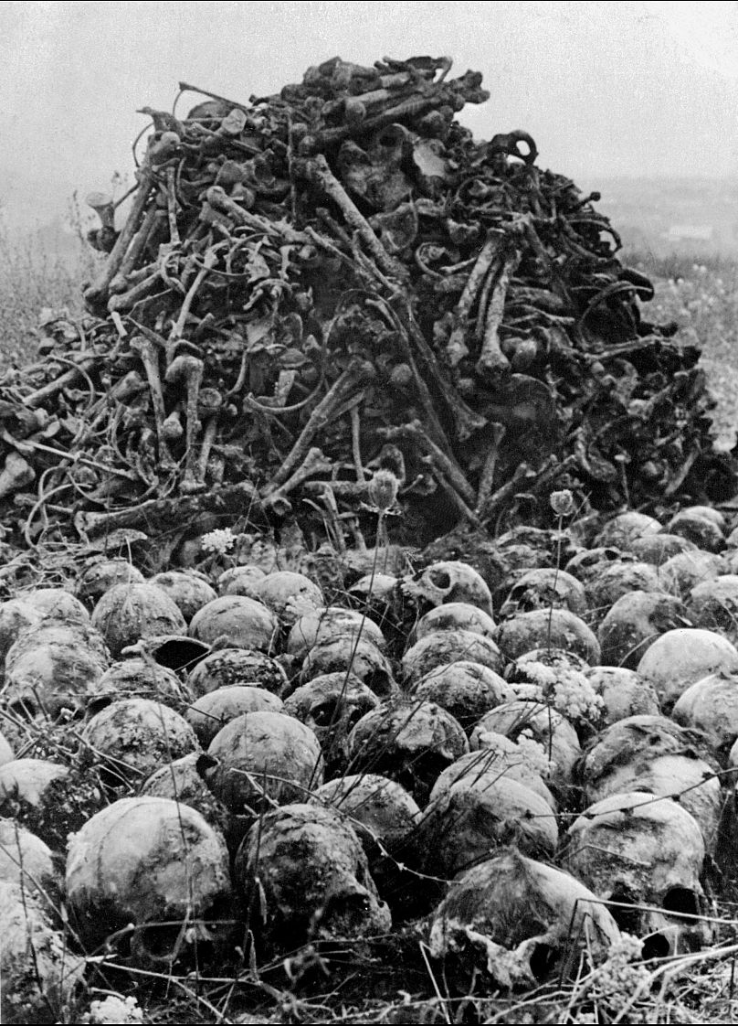
Holocaust
The Holocaust lasted from 1933 to 1945.
During the course of the genocide, about 6 million Jews were killed.

Slide 4
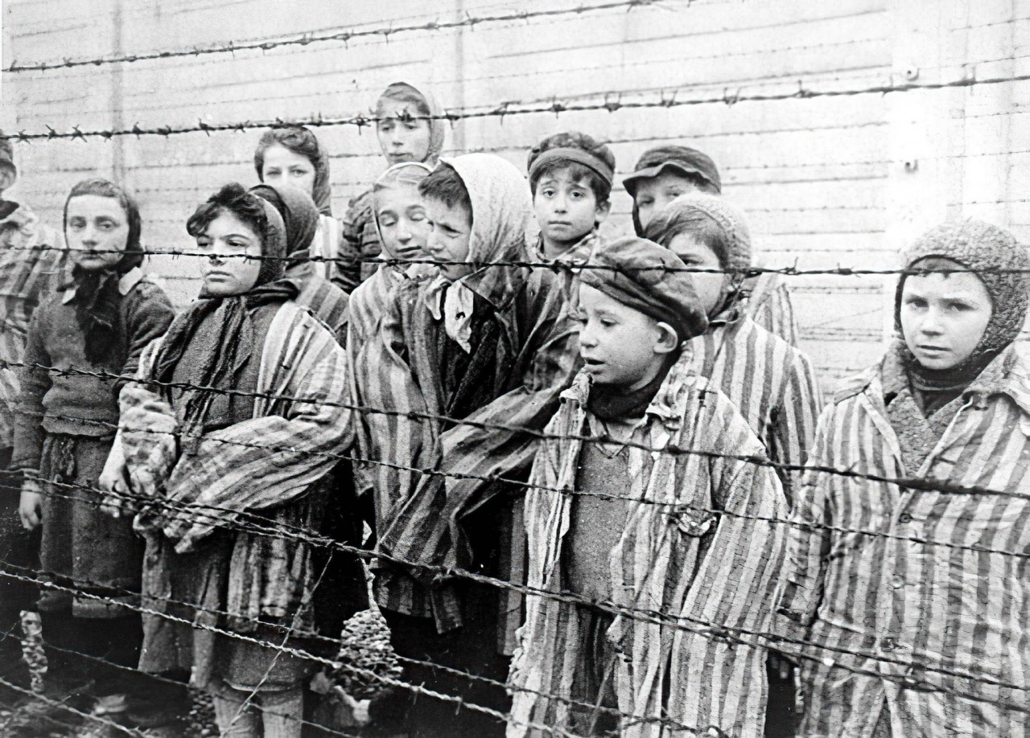
Holocaust
Even women and children were not spared in the Holocaust.
Hitler's goal was to exterminate Jews, Muslims, people of homosexual orientation, etc.
Hitler wanted to achieve racial superiority.

Slide 5
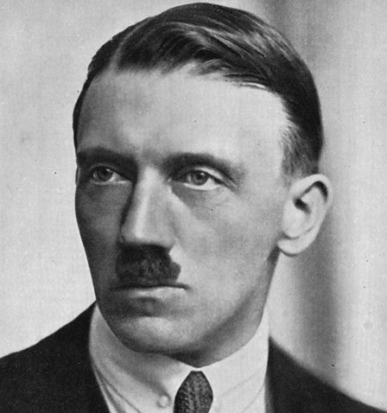
Adolf Hitler
Adolf Hitler was born in 1889 in the Austrian town of Braunau.
Adolf had a difficult childhood.
He was very gifted and loved to read books.
He tried to avoid military service and fled to Munich in 1913.

Slide 6
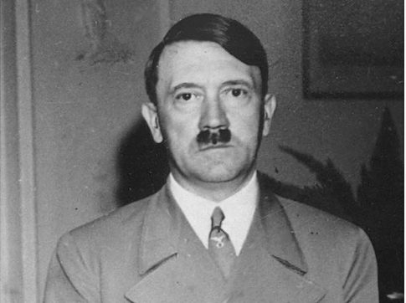
Adolf Hitler
He turned the Hindu symbol representing the sun and fertility into the worst thing in human history.
His reign represents the darkest part of history.
He wanted to impose his idea based on racial inequality.

Slide 7
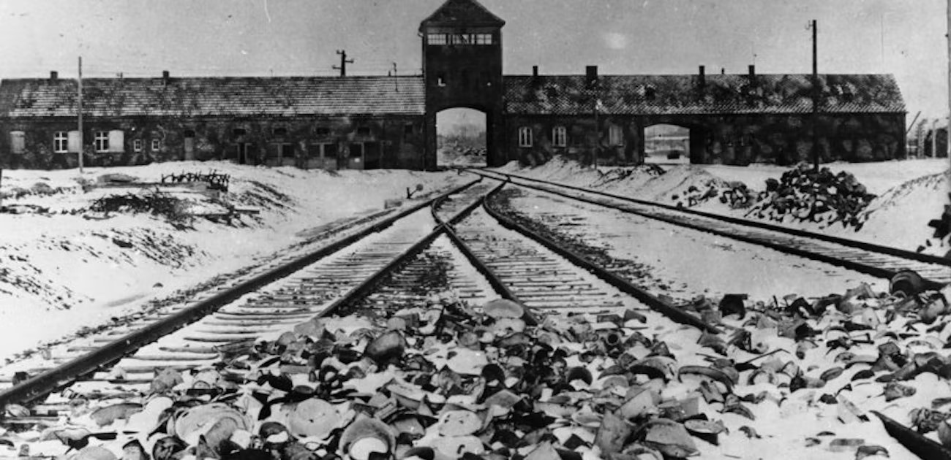
Auschwitz
„Factory of death"
Auschwitz is located in south Poland, west of Krakow.
The only Croatian witness to Auschwitz was Oleg Mandić.

Slide 8
Auschwitz
Trailer of a shocking film about Auschwitz.

Slide 9
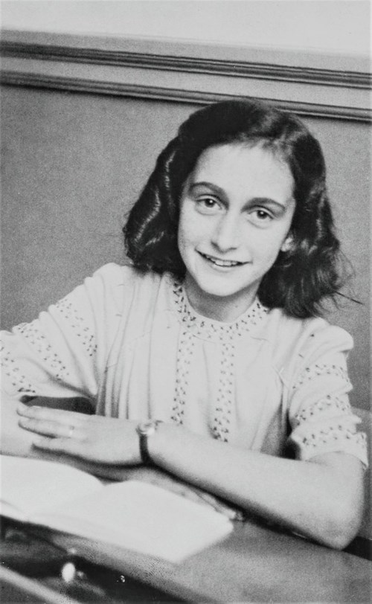
Anne Frank
Anne Frank was born in Frankfurt in 1929 and died in the Bergen-Belsen concentration camp in 1945.
She is the author of a diary in which she testifies to us about all the events that happened during that genocide.

Slide 10
Diary of Anne Frank

Slide 11
Books and films
Many films have been made and books written about that terrible genocide.
Films: "Life Is Beautiful", „The Boy in the Striped Pyjamas”, "A Love to Hide" and "Sophie's Choice" are films worth spending time on because they are very emotional and educational, they show us the harsh truth of the Holocaust.
Books: "Last Stop Auschwitz", "Diary of Anne Frank", "Women from the Castle" are also very moving books for everyone who likes emotional books.

Slide 13
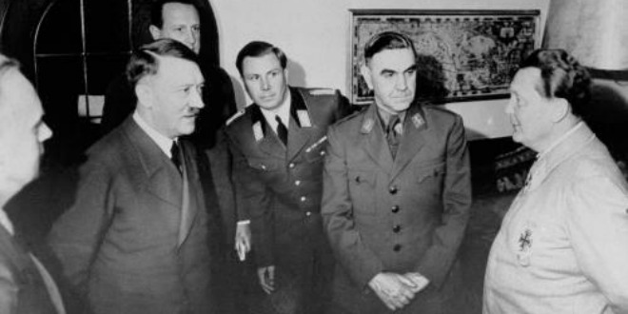
We can only learn from the holocaust how evil people can be.
Hitler is proof of how selfish and insensitive a person can be.
We can all agree that the Holocaust is something that should never happen again.

Slide 14
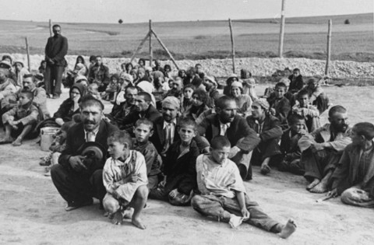
Innocent people, many children, women, invalids were killed because they were in the wrong place at the wrong time.
Unfortunately, we cannot change the past and bring back the murdered people, but we can change the future, although that may be difficult because we are like little pawns in the hands of politics.

Slide 16
Literature - sites
https://sites.google.com/site/holokaust111/sto-je-holokaust
https://vlada.gov.hr/vijesti/zrtve-holokausta-kojih-se-danas-sjecamo-podsjetnik-su-i-upozorenje-na-dimenzije-zla-koje-mogu-proizici-iz-mrznje/33805
https://scindeks.ceon.rs/article.aspx?artid=0353-90082052157H
http://povijest.net/2018/?p=1582
https://www.dw.com/hr/auschwitz-i-njegova-potresna-povijest/a-60562588
https://www.vecernji.hr/vijesti/rekli-su-nam-ovo-je-auschwitz-logor-za-istrebljenje-pa-su-me-poslali-mengeleu-na-odjel-za-blizance-1374855
https://nema-kompromisa.com/?p=1896
http://www.os-vela-luka.skole.hr/upload/os-vela-luka/images/static3/855/File/Dnevnik-Ane-Frank.pdf

Slide 17
Literature - images
https://mobimg.b-cdn.net/v3/fetch/4e/4e62b8a9d69f9eb3cbe971848ad7d189.jpeg
https://express.24sata.hr/media/img/42/5d/0f0f81ec4c181f05f0f2.jpeg
https://static.euronews.com/articles/stories/05/32/00/36/808x1122_cmsv2_6f1afc68-53ad-5634-8e2e-88df0940626a-5320036.jpg
https://static.jutarnji.hr/images/slike/2021/01/27/o_9976663_1280.jpg
https://ichef.bbci.co.uk/images/ic/448xn/p02n576b.jpg
https://povijest.hr/wp-content/uploads/2016/02/alg_hitler.jpg
https://wjc-dev.imgix.net/about-holocaust/assets/lu8YaFlw/bundesarchiv_b_285_bild-04413_kz_auschwitz_einfahrt.jpg?auto=format&fit=crop&fm=jpg&h=630&lossless=true&q=60&w=1300
https://ip.index.hr/remote/bucket.index.hr/b/index/5f07b0a6-c7bc-4517-9102-fa8eba056651.jpg?width=500
https://shop.skolskaknjiga.hr/media/catalog/product/cache/1/image/9df78eab33525d08d6e5fb8d27136e95/1/3/138970.jpg

Slide 18
Literature - images
https://www.google.com/url?sa=i&url=http%3A%2F%2Fzoomer.rs%2F5-najboljih-filmova-o-holokaustu%2F&psig=AOvVaw0jg4Fu-kLpel9xLMPEKteu&ust=1674423899767000&source=images&cd=vfe&ved=0CBAQjRxqFwoTCMD2jKHR2fwCFQAAAAAdAAAAABAE
http://zoomer.rs/wp-content/uploads/2022/01/life-is-beautiful-1024x576.jpeg
https://i0.wp.com/filmonizirani.net/wp-content/uploads/2015/06/the-boy-in-the-striped-pajamas-poster.jpg?ssl=1
https://m.media-amazon.com/images/M/MV5BMGY1YTU0YzQtOWQ2ZS00MWUxLTkxNmMtZjc1NTA1ZWY1NjE3XkEyXkFqcGdeQXVyNjc3MjQzNTI@._V1_FMjpg_UX1000_.jpg
https://images-na.ssl-images-amazon.com/images/S/pv-target-images/34b691f86a1de285fc7ff2044a247b7247385d386d70ae42d806c28bc075cf85._RI_V_TTW_.jpg
https://m.media-amazon.com/images/I/51IfDXZwMgL._AC_SY780_.jpg
https://cdn.waterstones.com/bookjackets/large/9780/2419/9780241952443.jpg
https://m.media-amazon.com/images/I/51VVuJSj7TL._AC_SY780_.jpg
https://radiogornjigrad.files.wordpress.com/2016/01/1-a-pav.jpg
https://rmcu.hr/wp-content/uploads/2020/02/Holokaust-i-koncentracijski-logori-1.jpg

