Slide 1
Holocaust remembrance day
Deni Šimić, Mihael Karadža, Marko Zirdum, Marin Majstorović

Slide 2
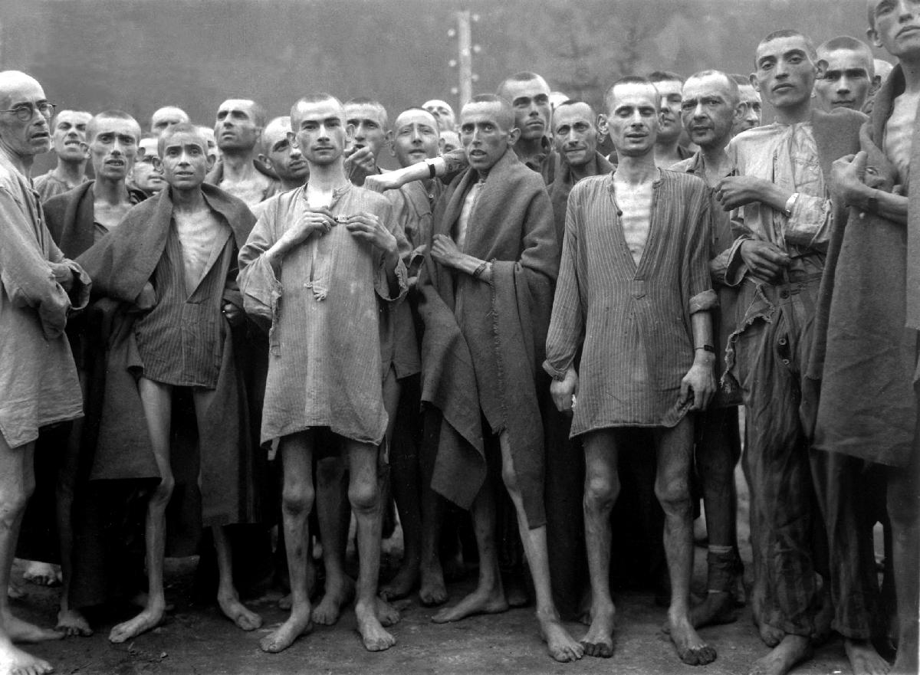
Holocaust
In translation: disaster
The name for the systematic state persecution and genocide of various ethnic, religious and political groups of people during World War II. by the Great German Reich and its collaborators

Slide 3
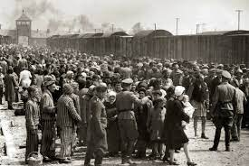
duration from 1941. to 1945.
Type of attack: systematic genocide, mass murder and ethnic cleansing
Dead: c. 6 million Jews
The motive: anti-semitism and racism

Slide 4
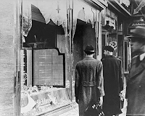
The beginning of the holocaust includes the persecutions during the Kristallnacht and the euthanasia program of actions T-4

Slide 5
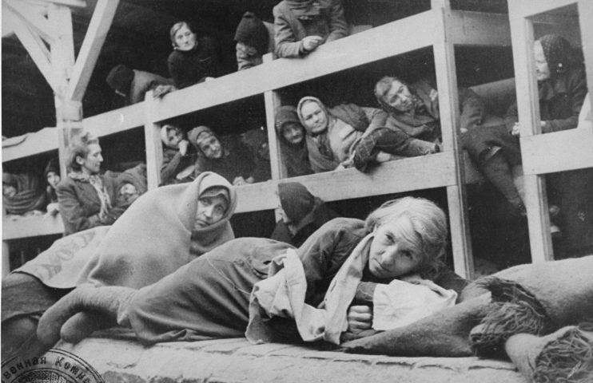
Holocaust victims
About two-thirds of the nine million Jews who previously lived in Europe were affected by the Holocaust
Jews suffered the most, around 6 million of them were killed

Slide 6
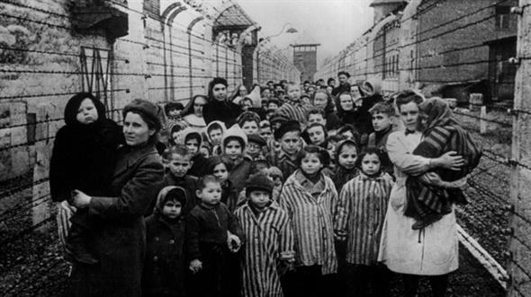
The victims were also Russians, prisoners of war, blacks and political opponents of the Nazis, and members of other minority groups
1.5 million children were killed.

Slide 7
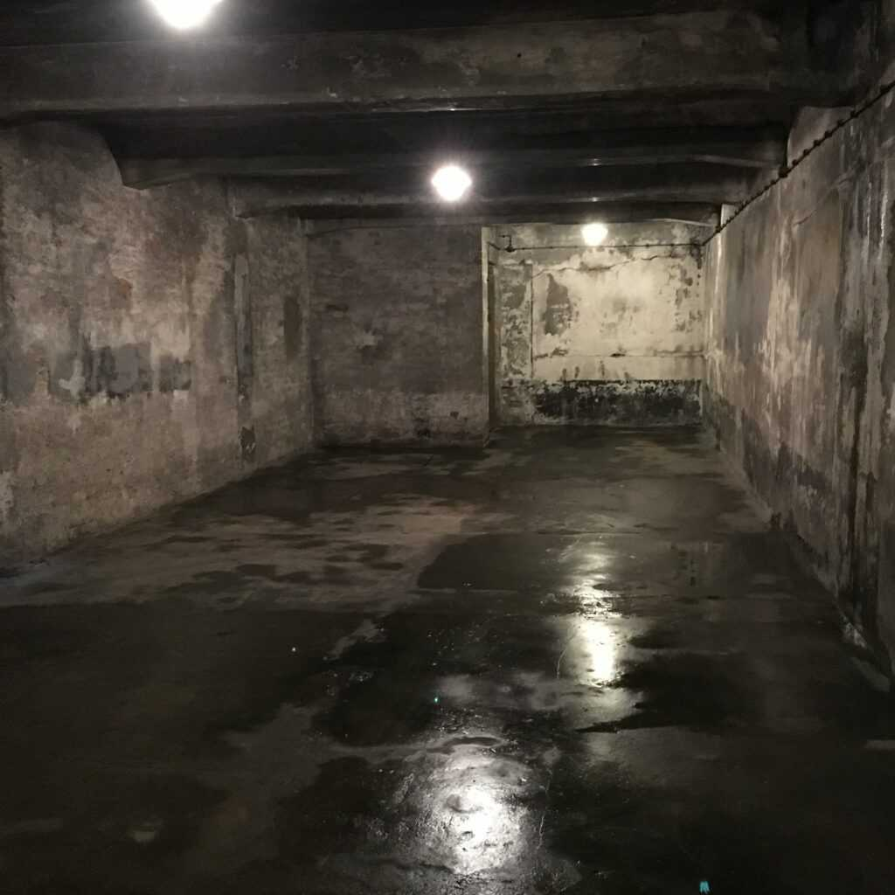
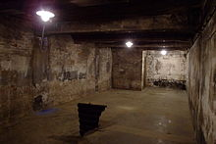
Concentration camps
A characteristic of the Holocaust was the use of concentration camps or death camps, equipped with gas chambers for the systematic mass extermination of people.

Slide 8
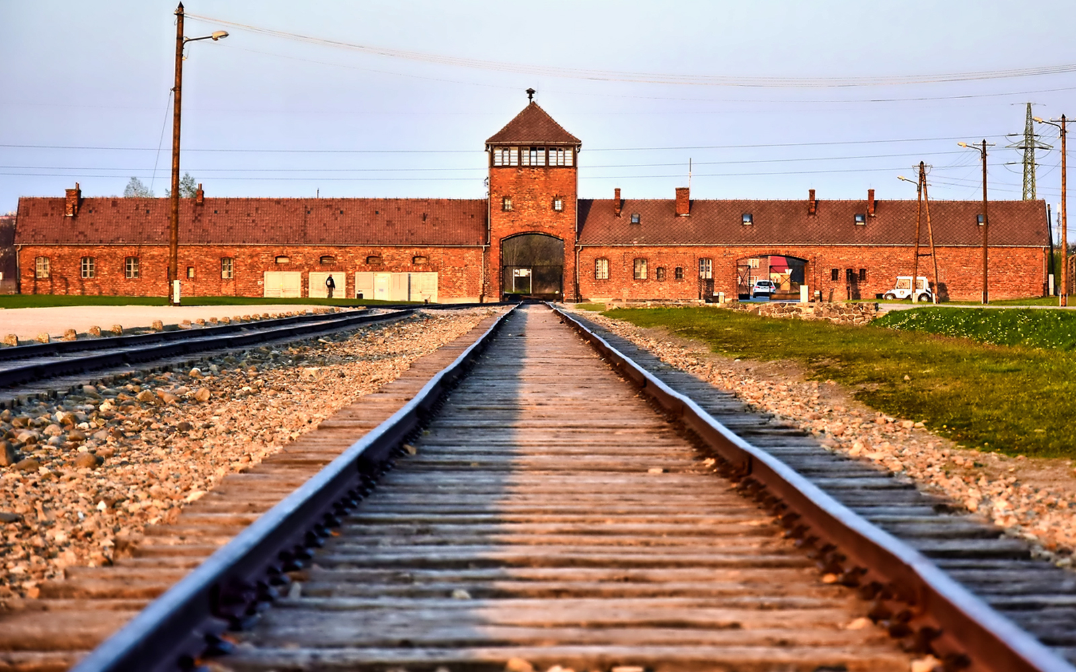
Auschwitz Birkenau
was a complex of over 40 concentration and extermination camps run by Nazi Germany
The place Poland under German occupation

Slide 9
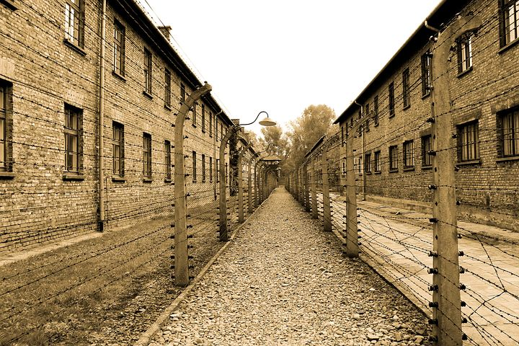
Number of prisoners At least 1.3 million
killed At least 1.1 million
Liberated from the Soviet Union on January 27, 1945
Auschwitz is the most famous concentration camp

Slide 10
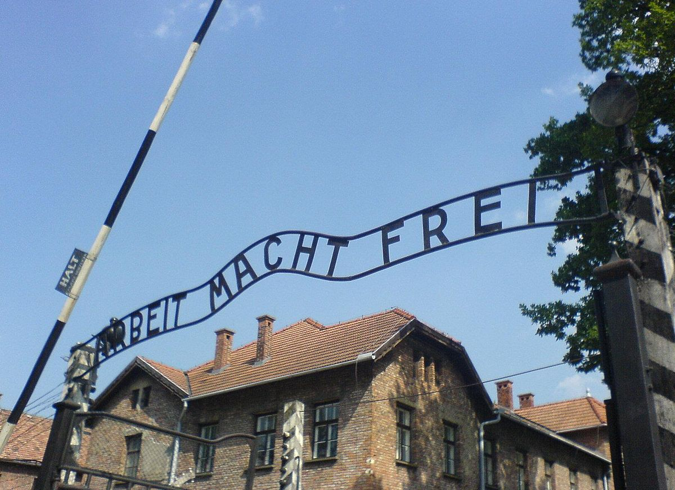
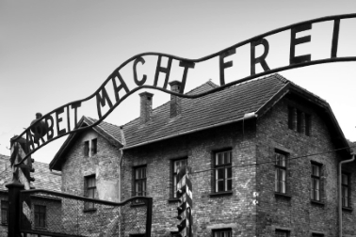
"Arbeit macht frei" is a German expression that translates to "work sets you free„
The expression became famous during the Second World War, because it was written at the entrance of the Nazi concentration camp Auschwitz

Slide 11
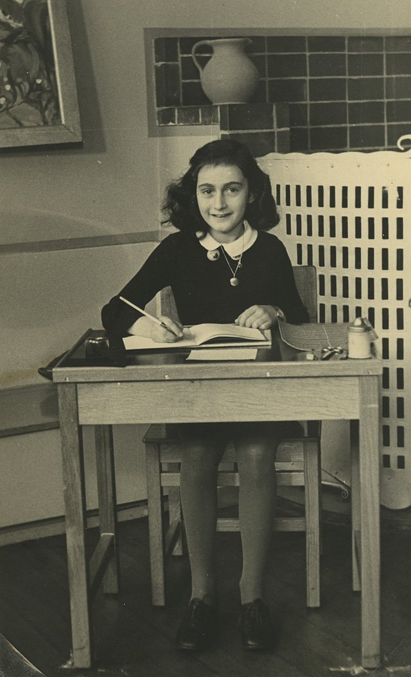
Diary of Anne Frank
The Diary of Anne Frank is a book based on the texts from the diary written by a Jewish girl Anne Frank during a period of two years when she and her family hid from the Nazi occupiers who occupied the Netherlands.

Slide 12
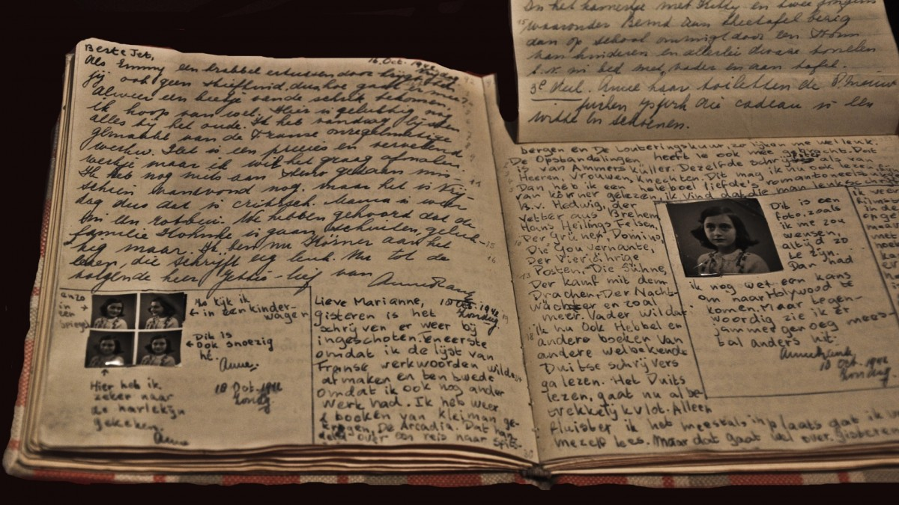
The family was arrested in 1944, and Anne Frank died of typhus in the Bergen-Belsen concentration camp in 1945.
After the war, the diary was found by Anna's father, Otto Frank, the only surviving member of the family
The diary is published in more than 60 languages.

Slide 13
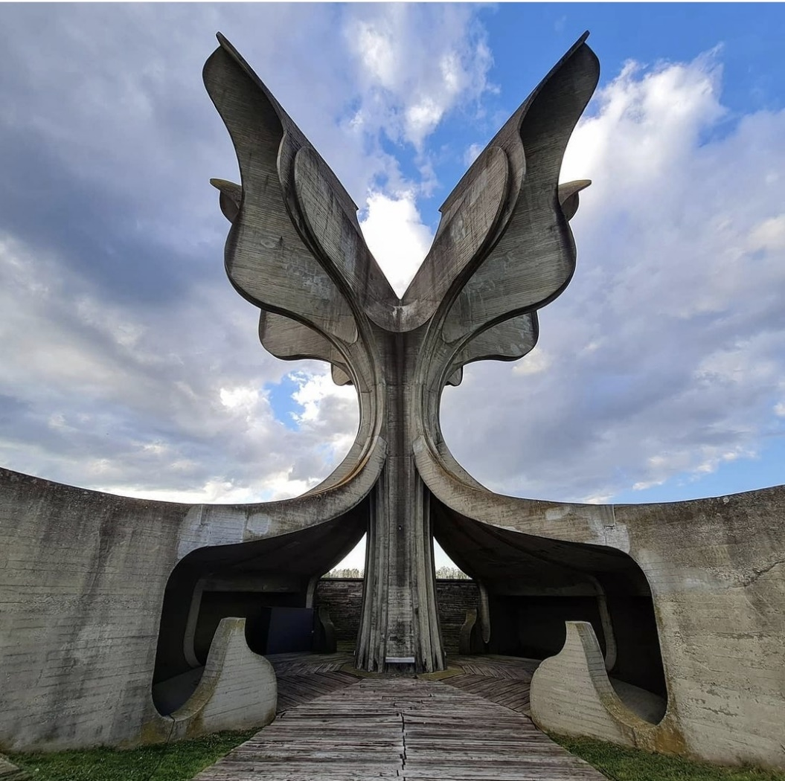
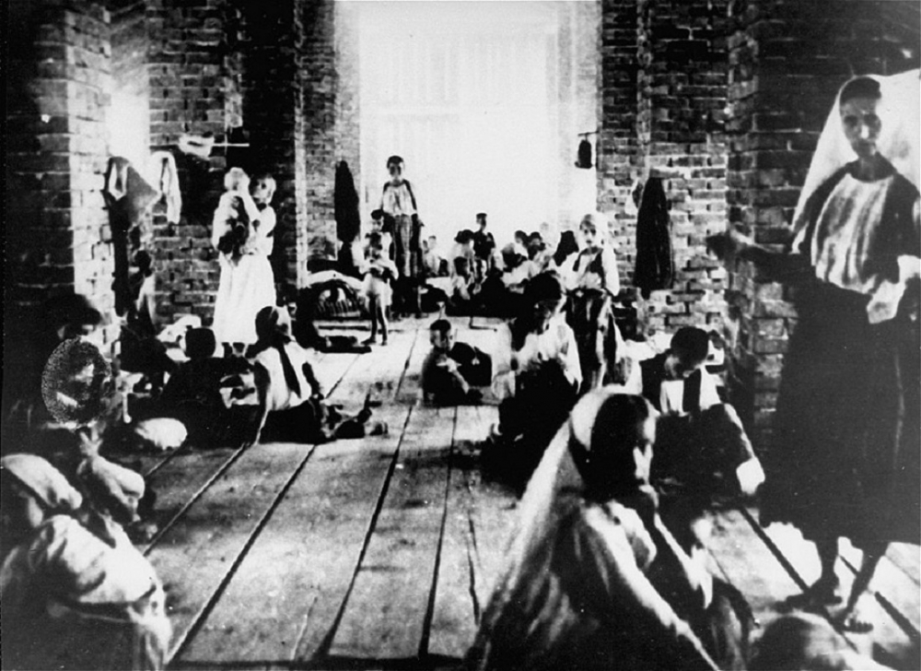
The Holocaust in the Independent State of Croatia (NDH)
Between 70,000 and 100,000 prisoners were killed in Jasenovac, the only death camp in Europe that was not under German administration

Slide 14
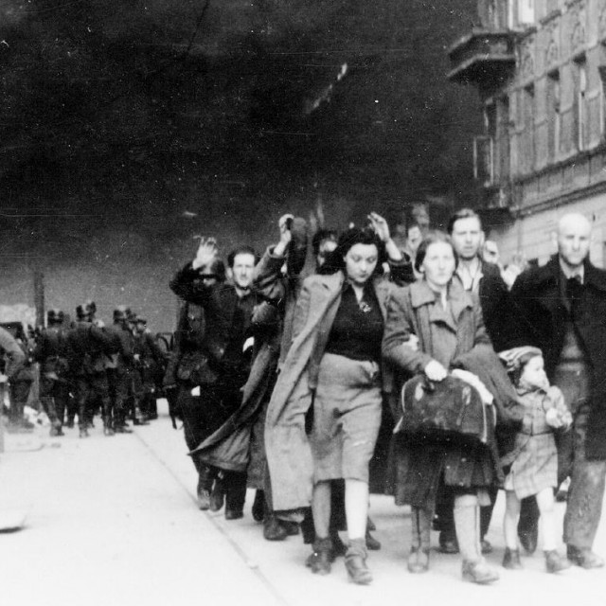
Aftereffect
the number of Holocaust victims is usually estimated at 9 to 11 million
The demographic picture in Europe has changed significantly, especially in Eastern and Central Europe, where Jewish communities have ceased to exist

Slide 15
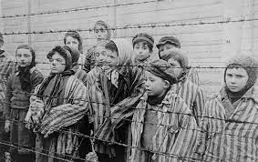
The Holocaust is often described as a unique event in world history, that is, responsibility for it is attributed to a limited number of people - most often Adolf Hitler himself and a narrow circle of his supporters

Slide 16
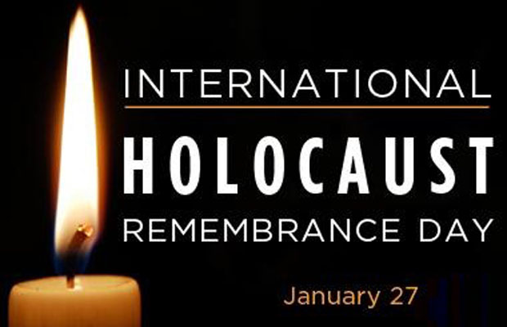
Holocaust Remembrance Day
Holocaust Remembrance Day is celebrated today in the USA and in all European countries.

Slide 17
SOURCES:
https://www.google.com/url?sa=i&url=https%3A%2F%2Fbiblyia.wordpress.com%2F2015%2F12%2F28%2Fstrahote-rata-holokaust%2F&psig=AOvVaw0dUJ8480KiPPomwApyOmTB&ust=1674475297443000&source=images&cd=vfe&ved=0CBAQjRxqFwoTCPjz39iQ2_wCFQAAAAAdAAAAABAE
https://sites.google.com/site/holokaust111/pocetak-holokausta
https://www.giornal.hr/wp-content/uploads/2022/01/Auschwitz-Birkenau-1944.jpg
https://www.hraction.org/wp-content/uploads/2020/01/Ausvic-742x480.jpg
https://www.kzz.hr/sadrzaj/novosti/75-obljetnica-holokausta/75-obljetnica-holokausta_590.jpg
https://isretanput.com/wp-content/uploads/2022/02/IMG_9547-min-1024x1024.jpg
https://upload.wikimedia.org/wikipedia/commons/thumb/e/ee/Auschwitz_14.JPG/220px-Auschwitz_14.JPG
https://cdn-imgix.headout.com/tour/26925/TOUR-IMAGE/49abe2a9-cd19-4df1-aa8a-71b5f0d9b9b4-14185-krakow-from-krakow--guided-tour-of-auschwitz-birkenau-with-fast-track-entry-05.jpg

Slide 18
https://cdn.pixabay.com/photo/2014/07/06/16/49/auschwitz-385639__480.jpg
https://upload.wikimedia.org/wikipedia/commons/thumb/6/6f/Auschwitz_entrance.JPG/1200px-Auschwitz_entrance.JPG
https://madrugada.blogs.com/.a/6a01b7c92b1ddf970b01b7c933202b970b-pi
https://upload.wikimedia.org/wikipedia/commons/thumb/9/95/AnneFrankSchoolPhoto.jpg/640px-AnneFrankSchoolPhoto.jpg
https://www.history.com/.image/t_share/MTU3ODc4NjAyMTc3MTkzMjg5/image-placeholder-title.jpg
https://novosti.hr/wp-content/uploads/2020/01/holokaust.jpg
https://documenta.hr/wp-content/uploads/2022/04/Screenshot_20220422-190109_Instagram.jpg
https://forum.tm/sites/default/files/styles/large/public/kolumna/kome-smeta-jasenovac-6866.jpg?itok=KpTdgHKc
https://static.jutarnji.hr/images/slike/2022/01/29/k_23477945_640.jpg
https://hr.wikipedia.org
http://www.sabor.hr
https://www.profil-klett.hr

Slide 19
End!

