Slide 1
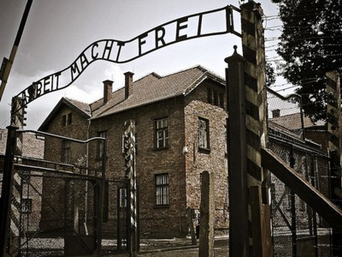
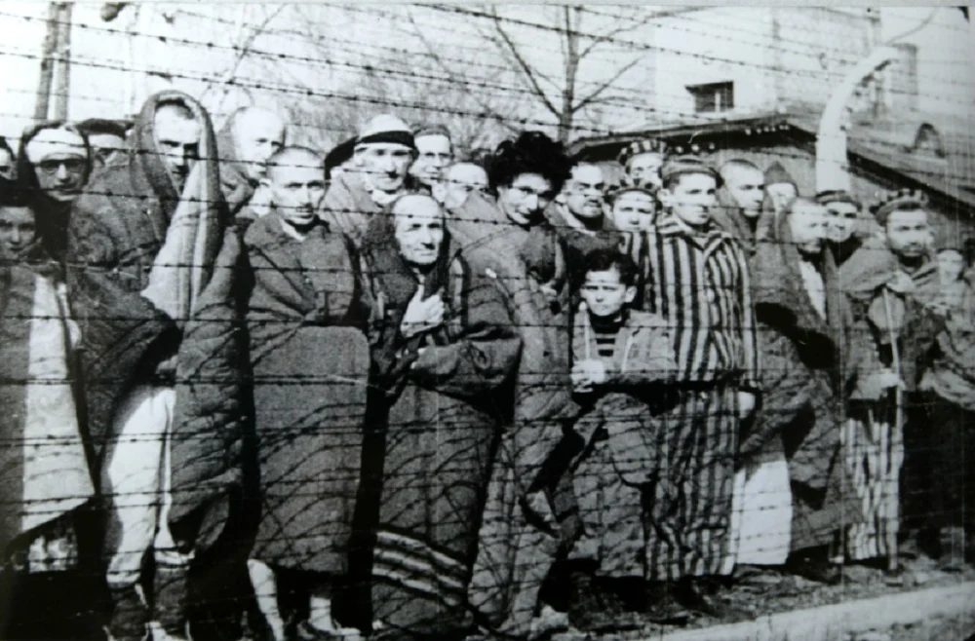
THE HOLOCAUST
PHOTO 1
Made by:Marko Kovačević, Marko Perak, Karlo matanović , Ivano Rozmarić
1.c
PHOTO 2

Slide 2
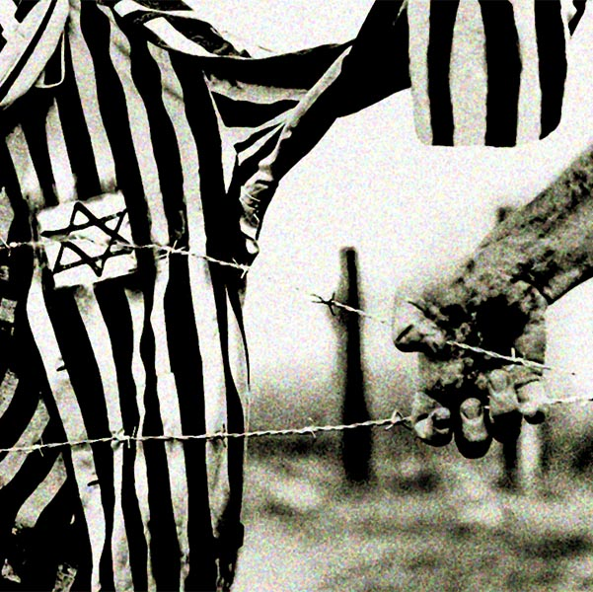
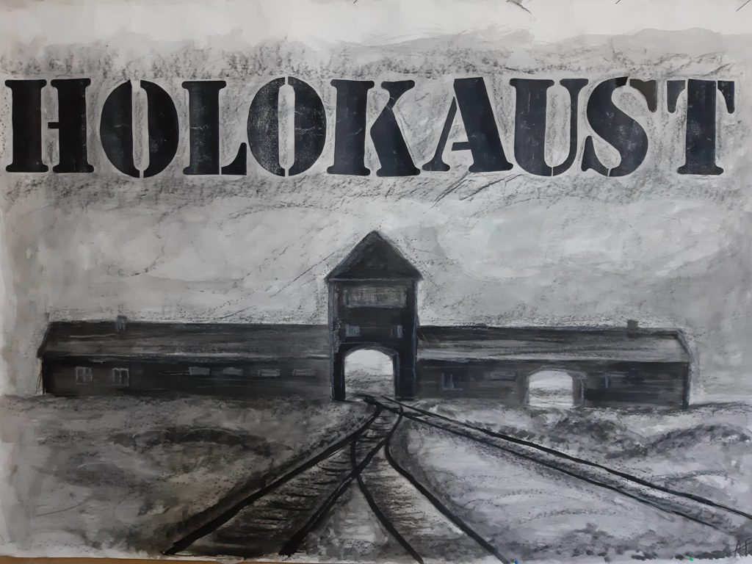
WHAT IS THE HOLOCAUST?
PHOTO 4
The Holocaust is a systematic and organized persecution of Jews.
The Nazis committed genocide against the Jews during World War II.
During the Holocaust, numerous concentration camps were opened.
PHOTO3

Slide 3
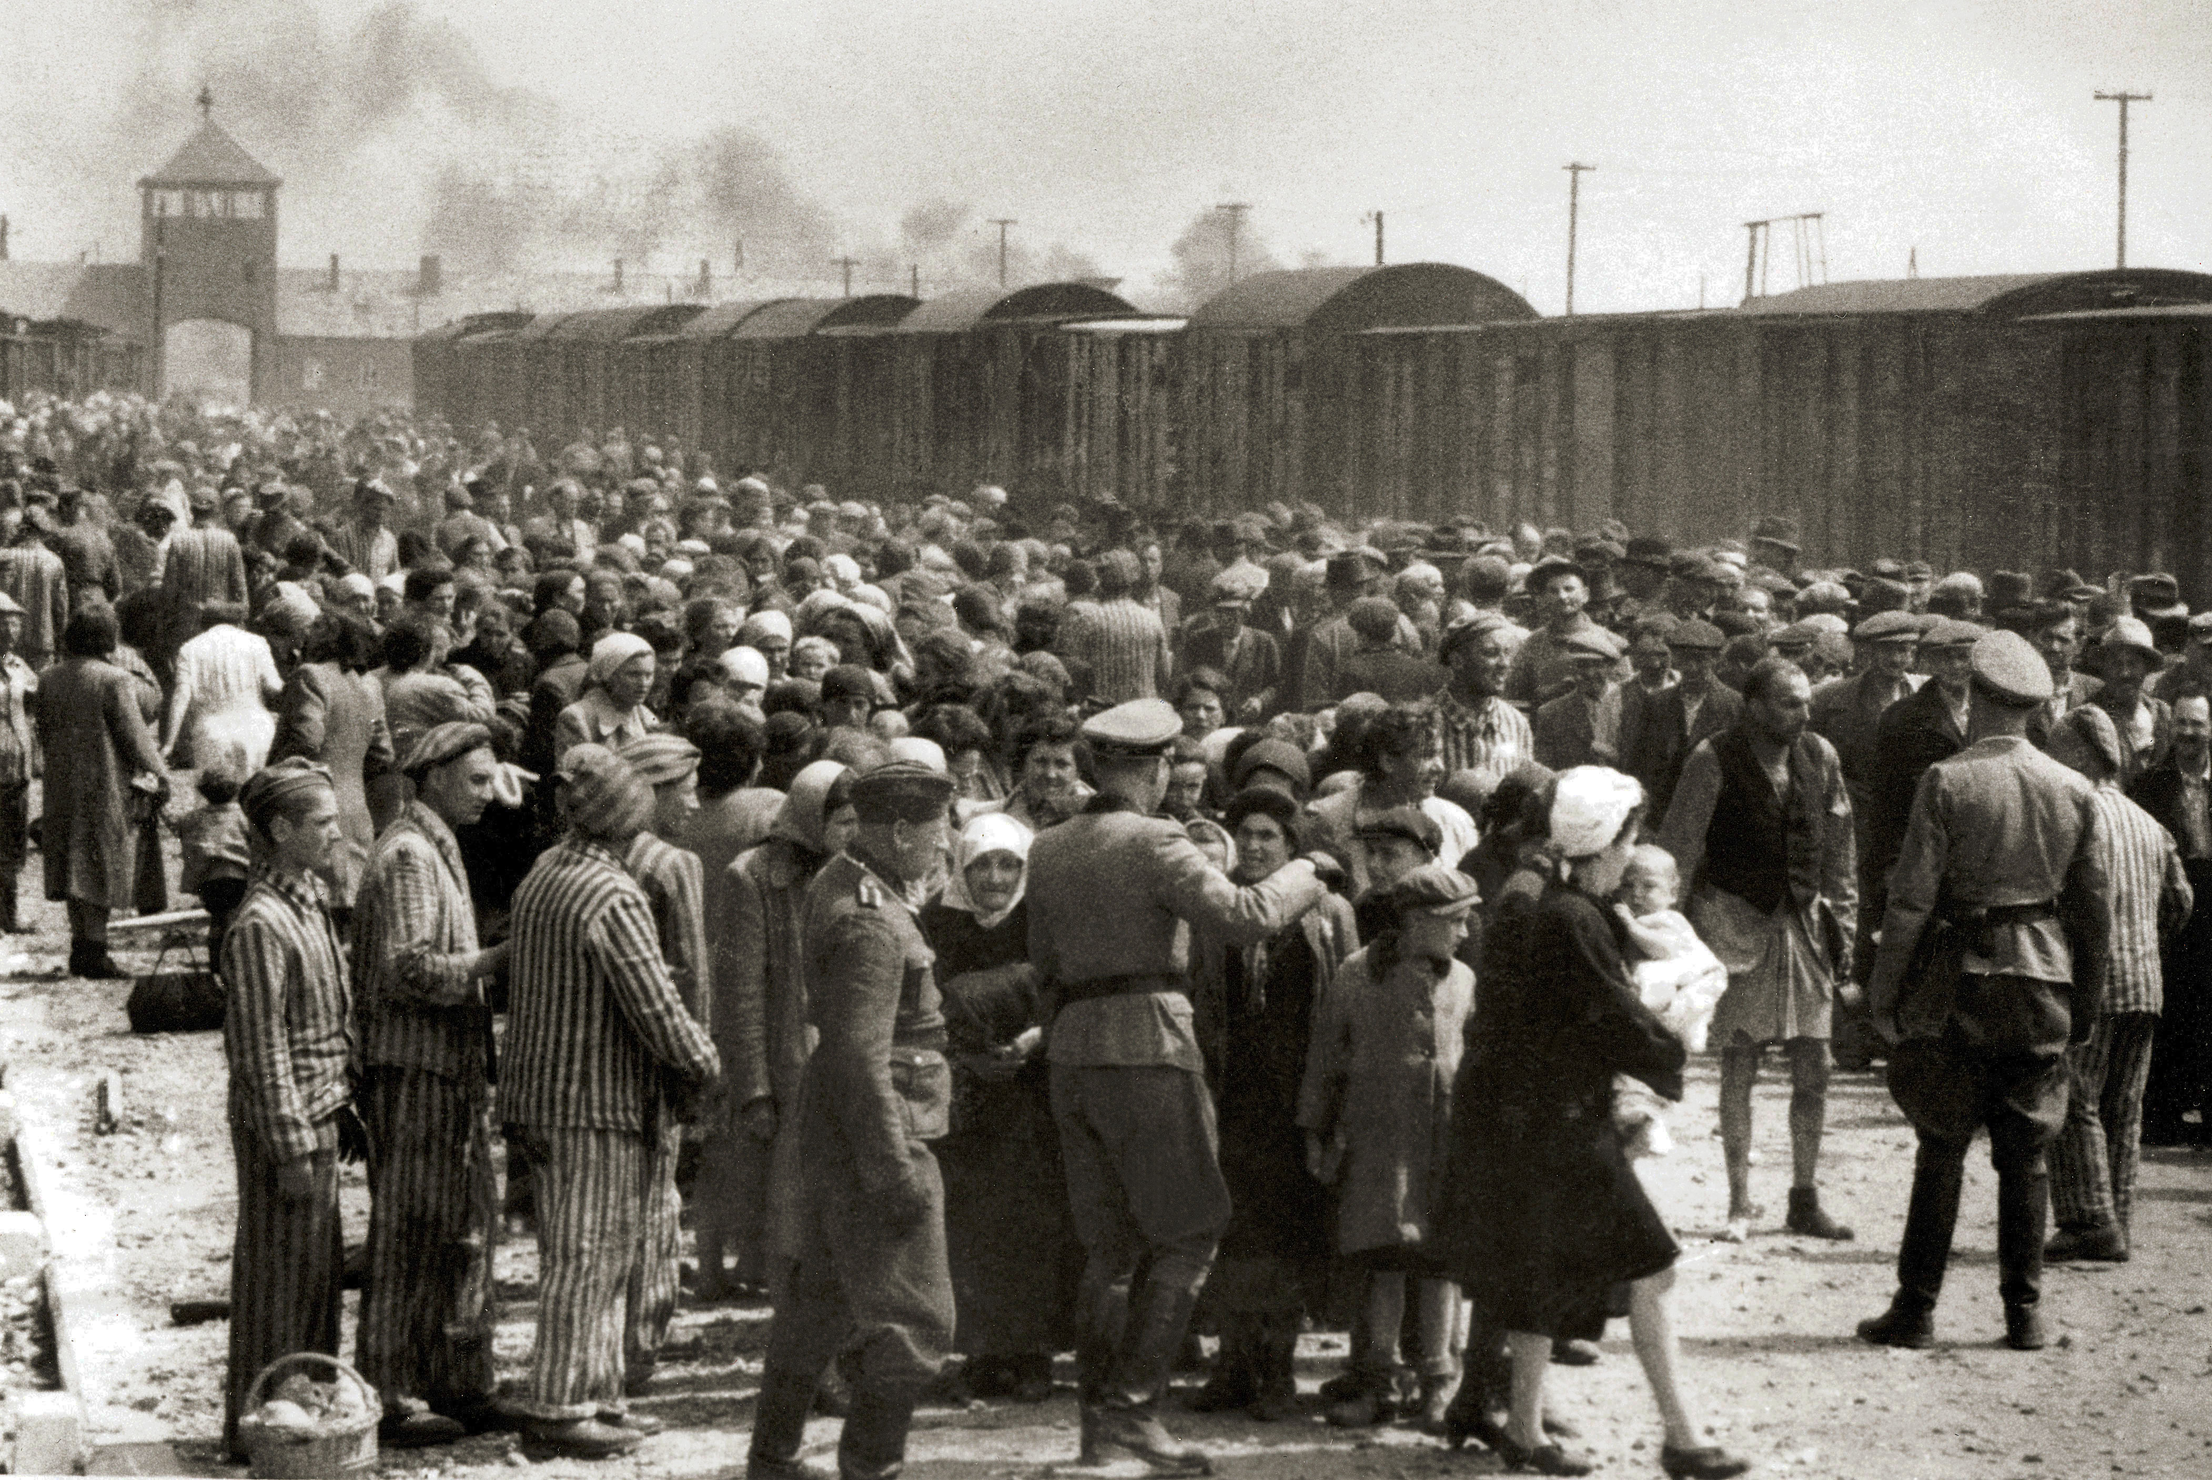
THE BEGINNING OF THE HOLOCAUST
In 1933., the Nazis came to power.
They ordered all Jewish books to be burned, and at that time Jews began to lose their freedom of speech and the freedom to spread their religion.
The Nazis started writing anti-Jewish laws.
PHOTO 5

Slide 4
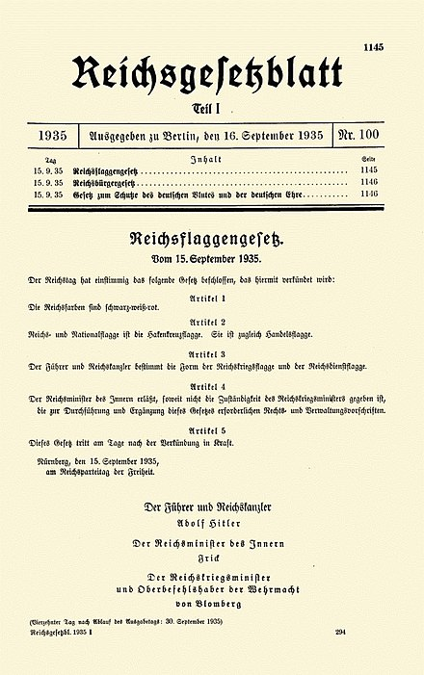
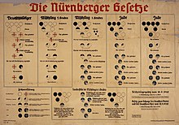
Nuremberg Laws
The Nuremberg Laws were enacted and entered into force in 1935 in Nazi Germany and remained in force until 1945.
In those laws, they emphasized the persecution of Jews, Roma and other races.
By those laws, Jews were forbidden to marry Aryans, they did not have the right to vote, and Jews were considered the lowest race.
PHOTO 6
PHOTO 7

Slide 5
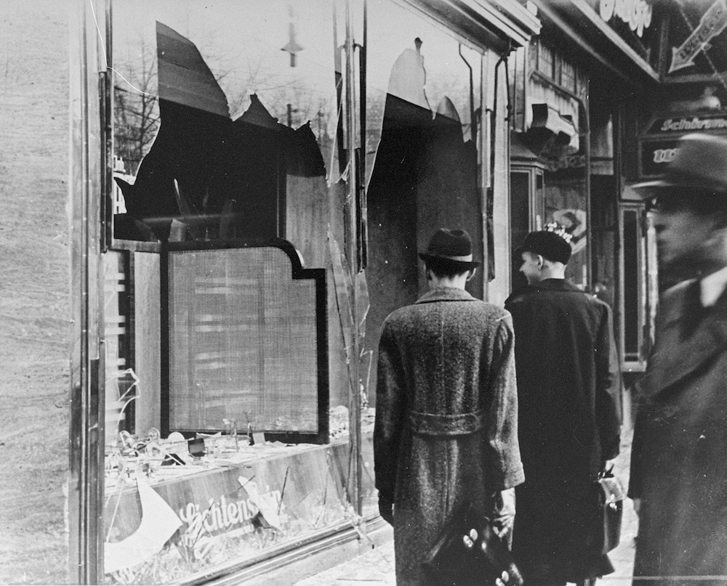
Kristallnacht
In October 1938, 15,000 Jews were expelled from Germany and landed at the Polish border.
The Polish government refused to accept the Jews and about 5,000 of them remained in no man's land.
As a sign of revenge, a 17-year-old Jewish boy named Herschel Grunspan assassinated the consul of the German embassy in Paris.
Because of this assassination on the night of November 9, 1938, the Nazis destroyed synagogues and Jewish shop windows throughout Germany and Austria.
That event is called Kristallnacht.
PHOTO 8

Slide 6
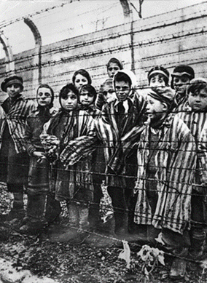
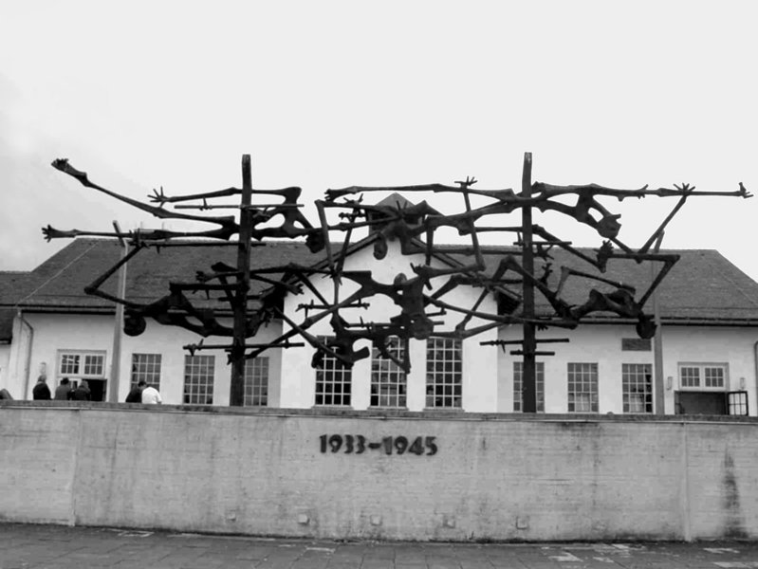
CONCENTRATION CAMPS
In 1941, Hitler decided to launch his project to destroy the Jews in Europe.
Jews were wanted by the secret police called the Gestapo and Jews were taken to camps.
Some of the most famous camps were Auschwitz, Belzec and Sobibor.
The camps were used for the mass killing of Jews and they used Jews as free labor.
The largest death camp was Auschwitz.
PHOTO 10
PHOTO 9

Slide 7
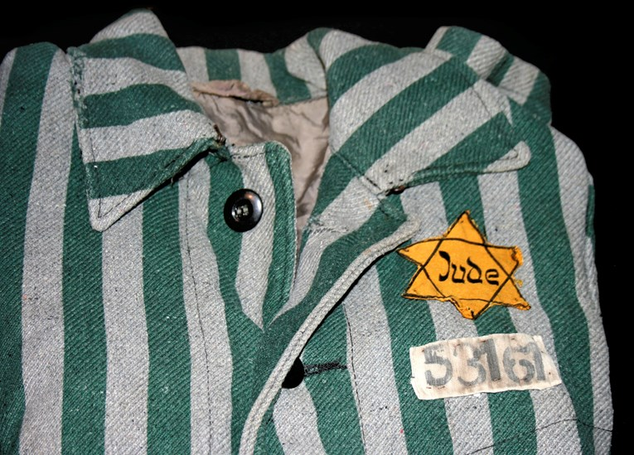
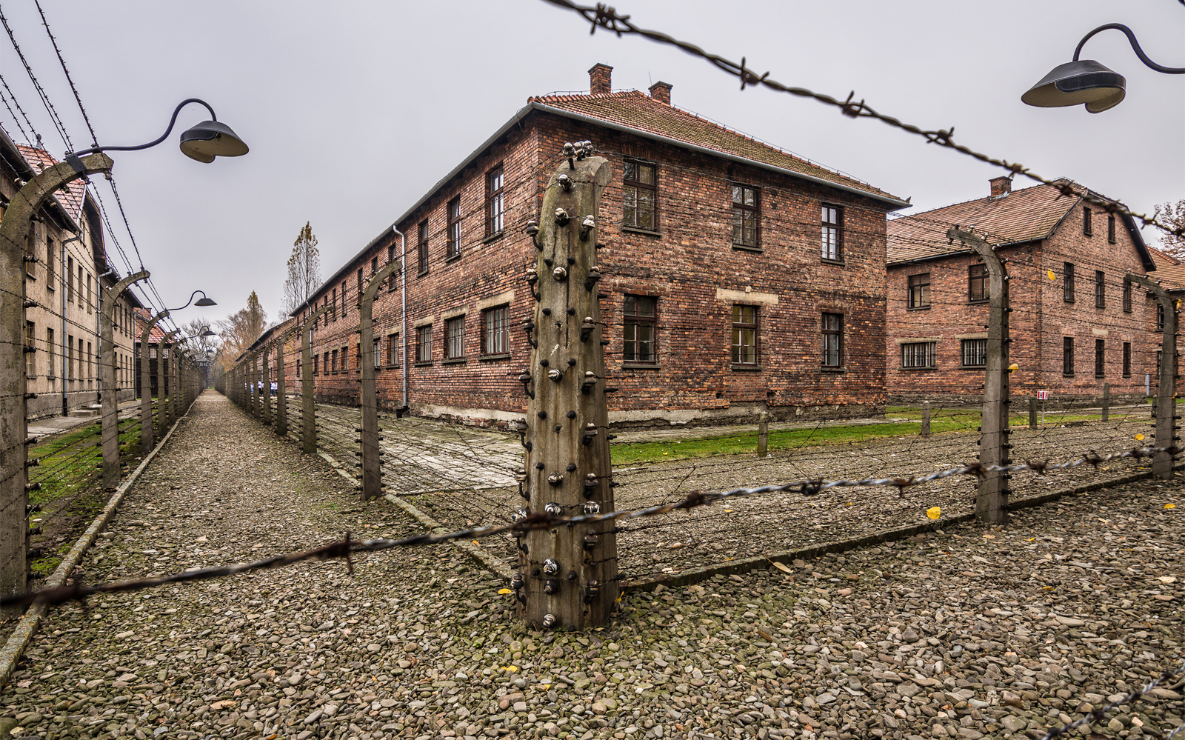
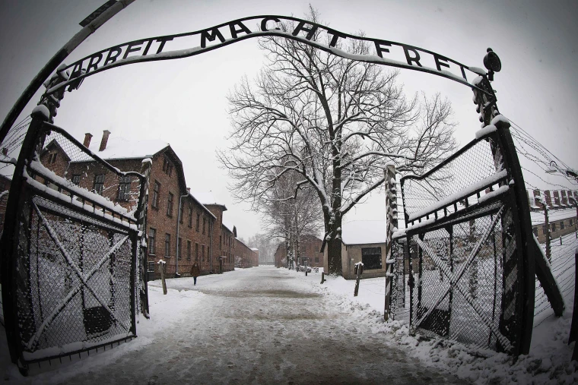
AUSCHWITZ
Auschwitz is the largest concentration camp of the Second World War.
It was located in Poland.
Auschwitz was an extermination camp for the Jews and it was a labor camp.
Auschwitz was famous for its gas chambers.
Most of the victims were killed in gas chambers,
About 1 million people were killed in Auschwitz, but the exact number is unknown.
PHOTO 13
PHOTO 11
PHOTO12

Slide 8
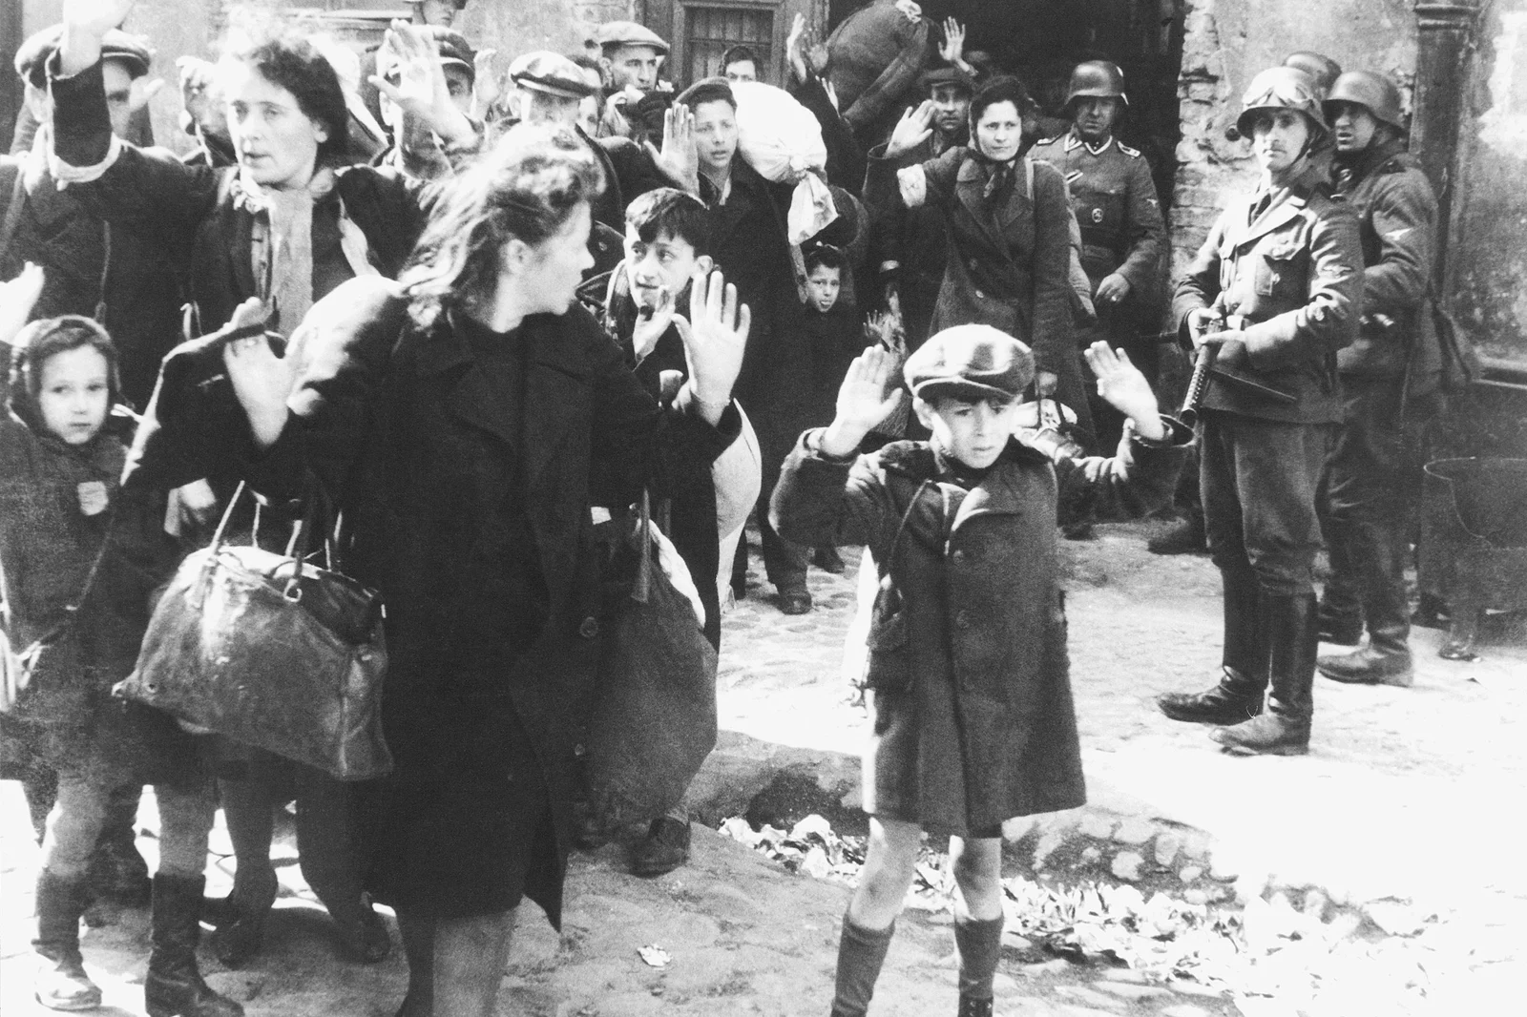
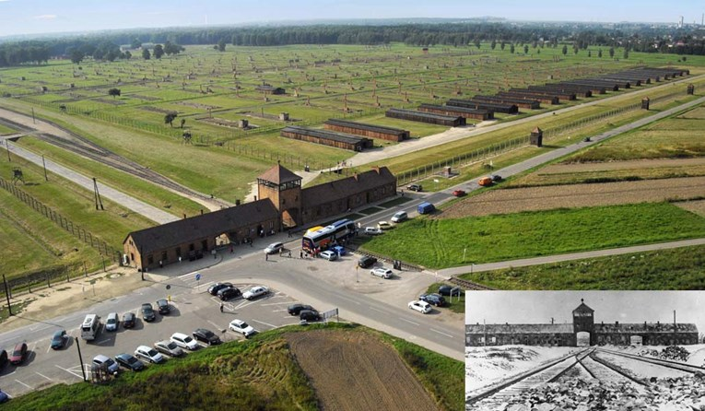
CONSEQUENCES
During the Holocaust, around 6 million Jews were killed.
The Roma were the second nation to be victims of the Holocaust.
Holocaust Remembrance Day is held on January 27th
PHOTO 14
PHOTO 15

Slide 9
THANKS FOR YOUR ATTENTION!

Slide 10
Literature:
PHOTO 1: https://www.civilnodrustvo.hr/wp-content/uploads/2017/01/holokaust_cr.jpg
PHOTO 2: https://direktno.hr/upload/publish/180299/cms-image-000007622_5e2bec08db19e.jpg
PHOTO 3: http://gav.hr/wp-content/uploads/2020/01/84471332_2851587291591533_6984823309674217472_n-1024x768.jpg
PHOTO 4: https://www.vedra.hr/foto/thumbs/holocaust.jpg
PHOTO 5: https://upload.wikimedia.org/wikipedia/commons/3/3b/Selection_on_the_ramp_at_Auschwitz-Birkenau%2C_1944_%28Auschwitz_Album%29_1a.jpg
PHOTO 6: https://en.wikipedia.org/wiki/Nuremberg_Laws#/media/File:Nuremberg_laws_Racial_Chart.jpg
PHOTO 7: https://en.wikipedia.org/wiki/Nuremberg_Laws#/media/File:RGBL_I_1935_S_1145.jpg
PHOTO 8: https://www.ushmm.org/m/graphic/86838-1000x807.jpg
PHOTO 9: https://www.enciklopedija.hr/Ilustracije/HE6_0169.jpg
PHOTO 10: https://ip.index.hr/remote/bucket.index.hr/b/index/92494f86-2450-47c4-bc49-acc8178b1a16.jpg?width=765&height=447
PHOTO 11: https://cdn-imgix.headout.com/tour/26925/TOUR-IMAGE/6380a02d-aa23-41d0-9910-56d999e5f275-14185-krakow-from-krakow--guided-tour-of-auschwitz-birkenau-with-fast-track-entry-03.jpg
PHOTO 12: https://media-cldnry.s-nbcnews.com/image/upload/t_fit-1240w,f_auto,q_auto:best/newscms/2019_49/3128271/191202-auschwitz-decorations-mc-1202.JPG
PHOTO 13: https://ip.index.hr/remote/bucket.index.hr/b/index/73962309-992b-4a36-baae-36390d8dc2c6.jpg?width=765
PHOTO 14: https://ugc.futurelearn.com/uploads/images/43/f2/header_43f2f869-50da-4ca9-8ec0-d3b19352dd22.jpg
PHOTO 15: https://ip.index.hr/remote/bucket.index.hr/b/index/f1ae4e4d-23b8-4c23-9761-5a4681ca01f3.jpg?width=765

Slide 11
https://en.wikipedia.org/wiki/The_Holocaust
https://www.enciklopedija.hr/natuknica.aspx?ID=25975
https://encyclopedia.ushmm.org/content/en/article/introduction-to-the-holocaust
https://www.history.com/topics/world-war-ii/the-holocaust

