Slide 1
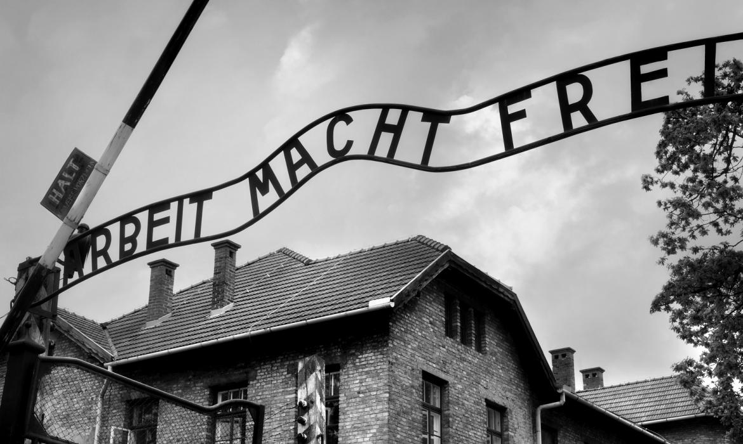
The Holocaust
Dorijan D, Marko K, Matej R, Petar S

Slide 2
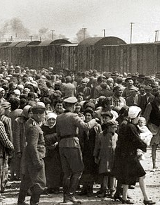
Holocaust
The holocaust was the genocide of European Jews during WW2
Nazi Germany murdered more than 6 millions Jews
Holocaust was during between 1941 and 1945
Holocaust starts at the 1933
Holocaust Remembrance Day was on the 27.1

Slide 3
Victims of the Holocaust
Victims of Nazi crimes are: Poles, Ukrainians and other Slavic people
Soviet prisoners of war are: communits, homosexuals, Jehovah's Witnesses and other
There are 200,000 perpetrators of the Holocaust

Slide 4
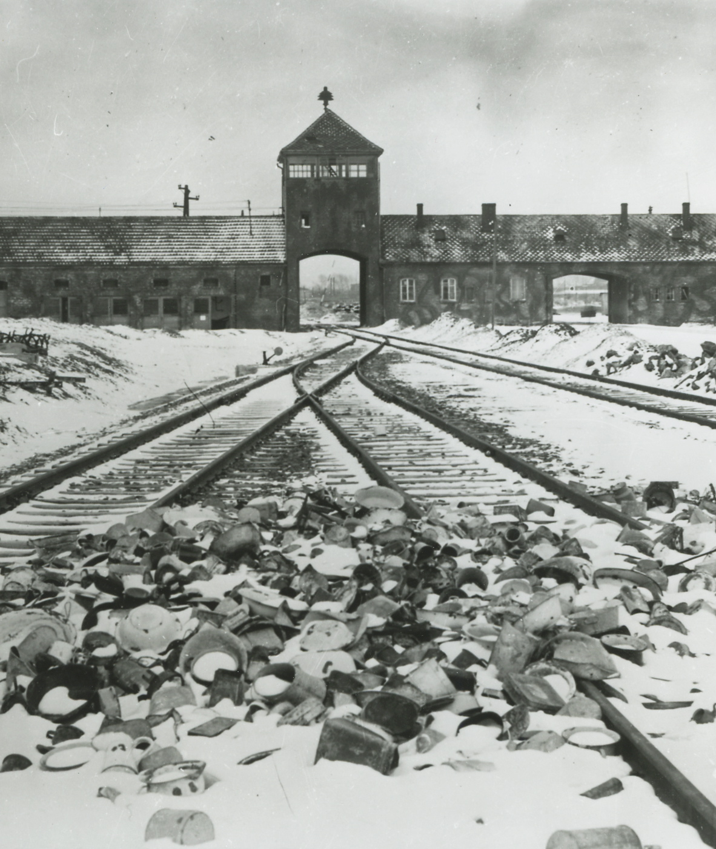
Auschwitz
Auschwitz was the largest concentration and labor camp of the Nazi Germany
It was located in Poland
The commander of camp was Rudolf Hoss, he killed more than 3 million people in his camp

Slide 5
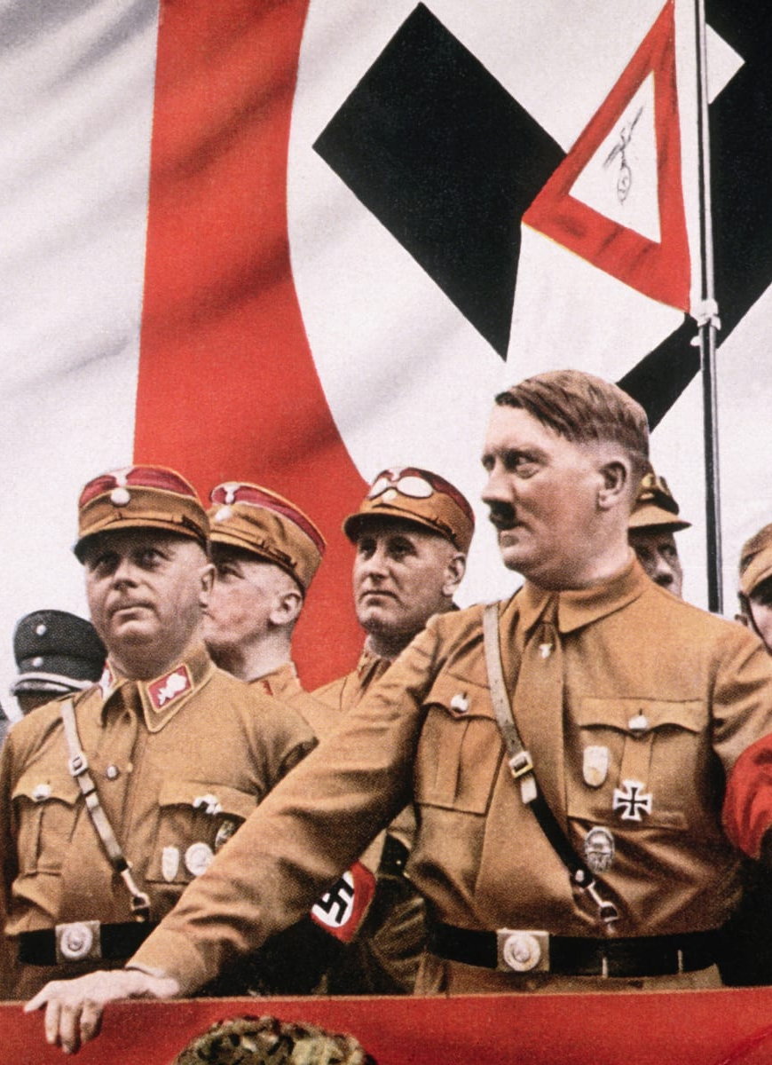
Adolf Hitler
Adolf Hitler was born in Germany, German politician
Leader of the National Socialist German Workers
Came to power in 1934, after Great Economic Crisis
Between 1942 and 1945, the SS wit Hitler killed more than 6 million Jews, homosexuals, communists and rome

Slide 6
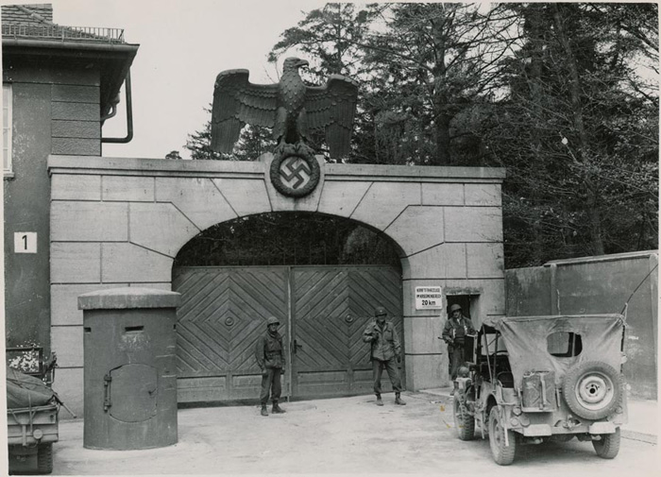
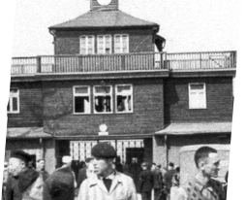
Concentration camps
From 1933 to 1945, Nazi Germany operated more than a thousand concentration camps
Some of the camps are: Dachau
Mauthausen
Auschwitz
Buchenwald
Flossenbürg
Sachsenhausen

Slide 7
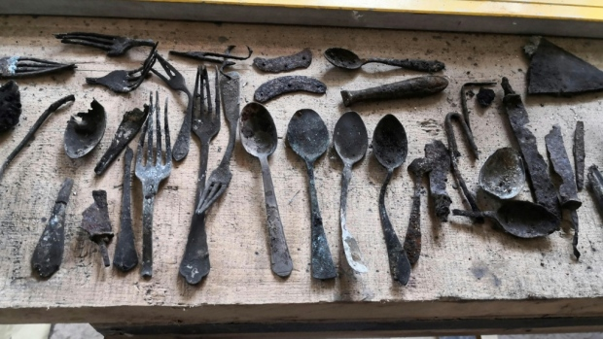
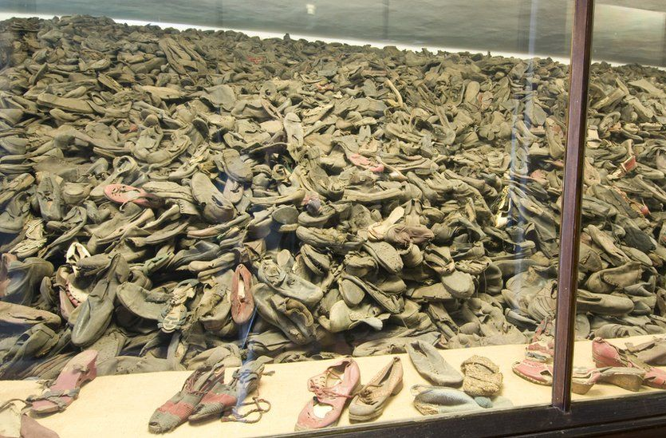
Things that are found in camps
Before they entered the camps they had to leave their things
Shoes, coats, pants, bags...

Slide 8
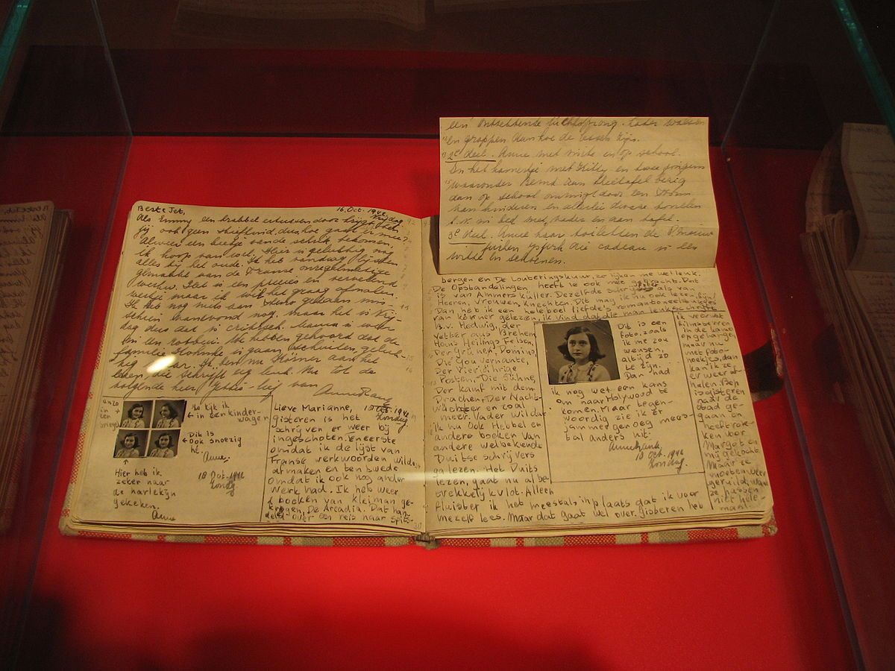
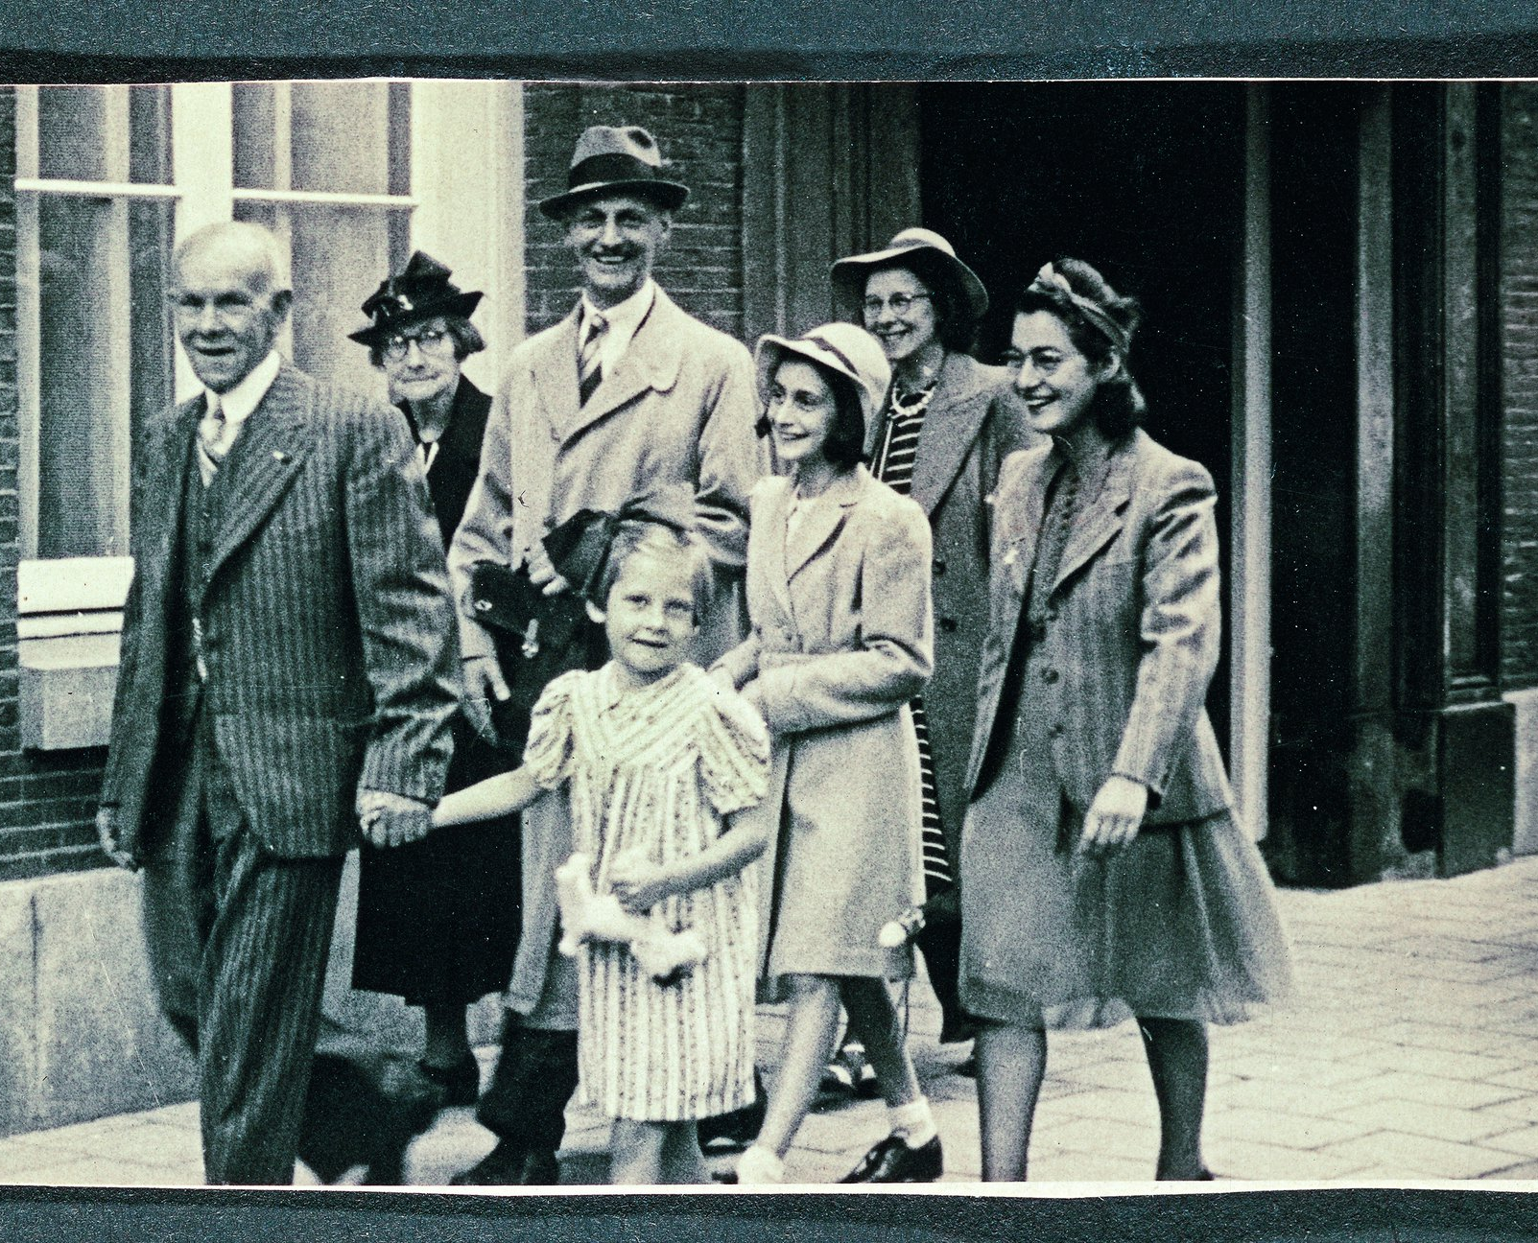
Anne Frank
Anne Frank was born in Frankfurt
When she was four and half she moved to Netherlands
Her family and she were hiding in the building, they hide there for 4 years
On 4 August 1944 gestapo find Anne Frank and her family
Gestapo put her in the Bergen-Belsen camp, where she died
Her dad release The Diary of a Young Girl on 25.6.1947

Slide 9
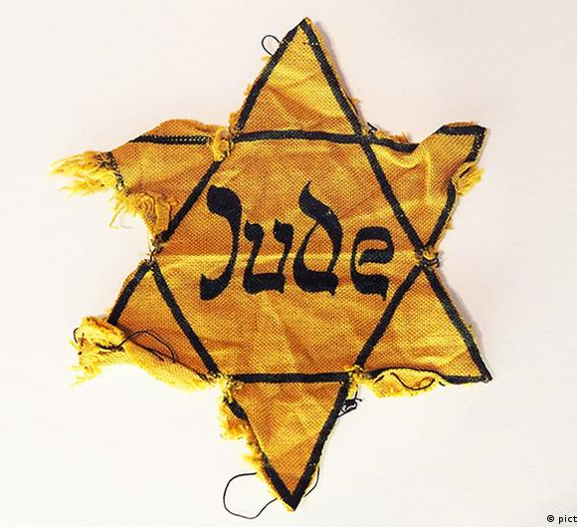
Jews in Holocaust
Jews had to wear a David star in the public
They were been limited
On Crystal Night the persecution of Jews has begun

Slide 10
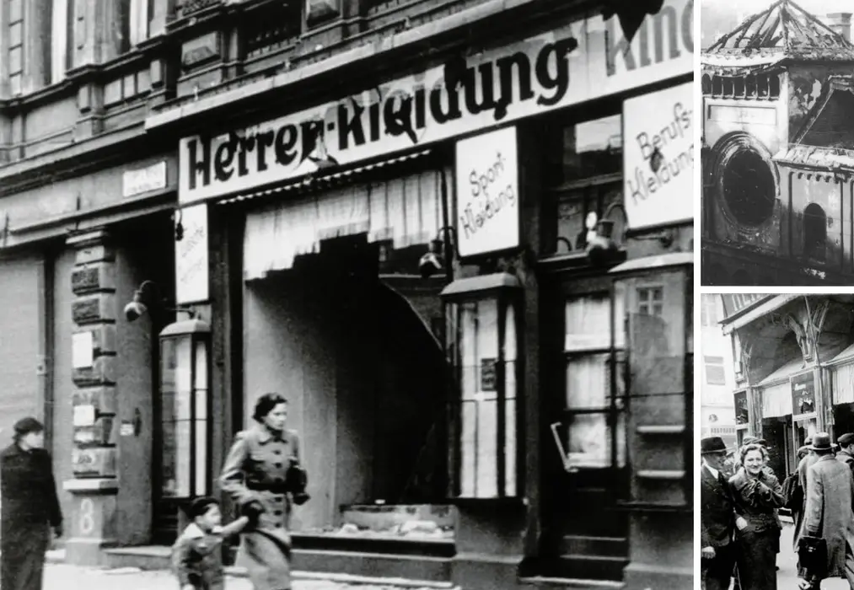
Cryistal Night
By order of Hitler in 1938 more than 12,000 Jews of Polish origin are gone to the camps
They were deported in trains to the Polish border
They was need to wait for days in difficult conditions before they allow them entry

Slide 11
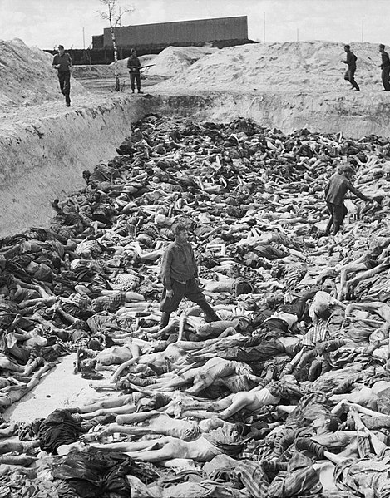
The killing ways in camps
Nazi Germans kill Jews with some ways
Some of them are: Gas chambers
Shooting
Difficult working conditions in camps
Sickness
They are doing experiments on Jews

Slide 12
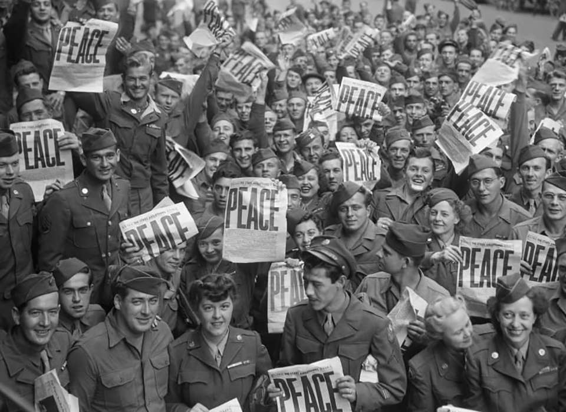
Aftermath
After WW2, 6 million Jews were killed
More crises
Migrations Jews in the USA
More of 200 thousands Roma are killed in WW2

Slide 13
Photo Sources
https://www.profil-klett.hr/sites/default/files/styles/sx_1170/public/dsc_0061bw.jpg?itok=4xTFPrAT
https://upload.wikimedia.org/wikipedia/commons/3/3b/Selection_on_the_ramp_at_Auschwitz-Birkenau%2C_1944_%28Auschwitz_Album%29_1a.jpg
https://media-cldnry.s-nbcnews.com/image/upload/newscms/2021_37/3198501/200123-auschwitz-mc-8473.JPG
http://ocdn.eu/images/pulscms/NjE7MDA_/9b75eeab254dc9e43bb176dba5bbdac4.jpg
https://www.history.com/.image/ar_16:9%2Cc_fill%2Ccs_srgb%2Cfl_progressive%2Cg_faces:center%2Cq_auto:good%2Cw_768/MTk1MTQzMjg1OTYwODc3MjU1/adolf-hitler-gettyimages-119505258.jpg
https://upload.wikimedia.org/wikipedia/commons/4/4f/KZDachau1945.jpg

Slide 14
Photo Sources
https://static.dw.com/image/16048933_101.jpg
https://c.files.bbci.co.uk/17E4B/production/_112376879_061541656.jpg
https://i.ytimg.com/vi/CtsCoKmGWdc/maxresdefault.jpg
https://www.history.com/.image/t_share/MTU3ODc4NjAyMTc3MTkzMjg5/image-placeholder-title.jpg
https://annefrank.freetls.fastly.net/media/filer_public_thumbnails/filer_public/48/2a/482ab128-0b4b-4504-83d9-ddf19dce76fe/03_049_lv_juli_1941_00_13_02_anne_otto_ea_huwelijksdag_miep.jpg__2160x1296_q85_crop_subsampling-2_upscale.jpg

Slide 15
Photo Sources
https://static.dw.com/image/19502712_403.jpg
https://img.24sata.hr/GwlZMWXnSKGLvpSoQFVXDVH21qQ=/1243x700/smart/media/images/2021-45/dizajn-bez-naslova-2021-11-09t150115-886.jpg
https://www.nationalww2museum.org/sites/default/files/styles/wide_medium/public/2021-05/626815-wiki-american_military_personnel_gather_in_paris_to_celebrate_the_japanese_surrender.jpg
https://upload.wikimedia.org/wikipedia/commons/thumb/e/e1/Mass_Grave_at_Bergen-Belsen_concentration_camp_-_Fritz_Klein_-_IWM_BU4260.jpg/1024px-Mass_Grave_at_Bergen-Belsen_concentration_camp_-_Fritz_Klein_-_IWM_BU4260.jpg

Slide 16
Text Sources
https://hr.wikipedia.org/wiki/Holokaust
https://www.holocaustremembrance.com/hr/resources/educational-materials/sto-poducavati-o-holokaustu
https://abcgeografija.com/teme/holokaust/
https://hr.wikipedia.org/wiki/Koncentracijski_logor_Auschwitz
https://www.bbc.com/serbian/lat/svet-51224486
https://hr.wikipedia.org/wiki/Kristalna_no%C4%87
https://www.nationalww2museum.org/war/articles/holocaust
https://hr.wikipedia.org/wiki/Adolf_Hitler

