Slide 1
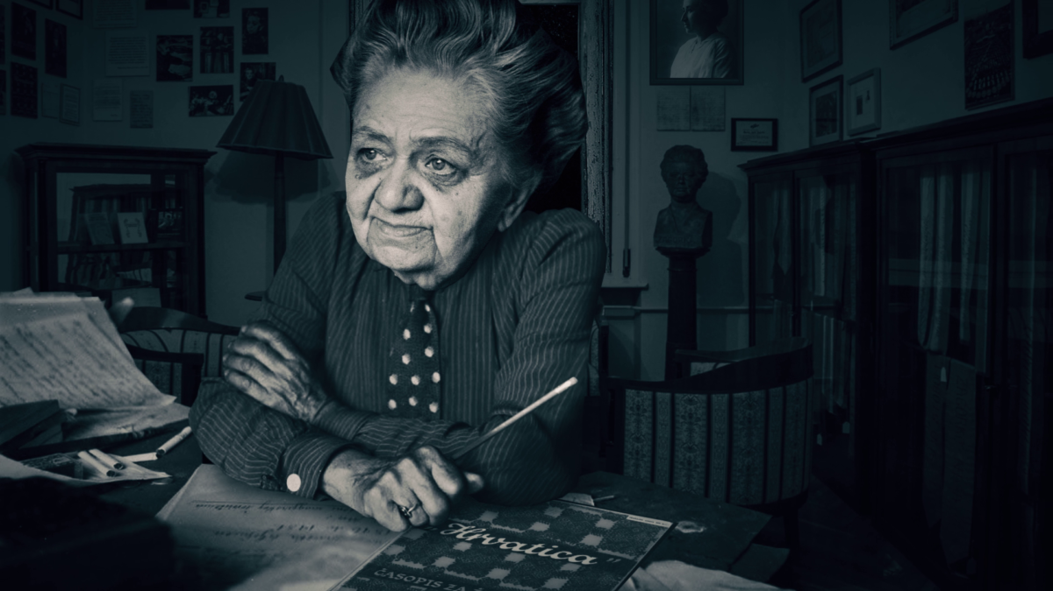
Marija Jurić Zagorka
Mentorica: Tatjana Dujić
Učenica: Iva Brozinić, 1.f

Slide 2
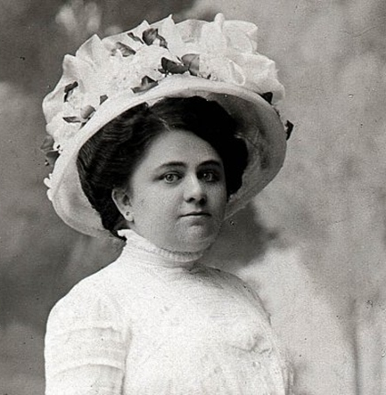
Zagorkin život
Marija je bila darovito dijete. Od malena je pisala i pokretala učeničke novine.
Roditelji joj nisu dopuštali školovanje te su je s nepunih osamnaest godina odlučili udati i poslati u Mađarsku.
Nakon tri godine braka pobjegla je od muža natrag u Zagreb te tada započinje svoju novinarsku karijeru.

Slide 3
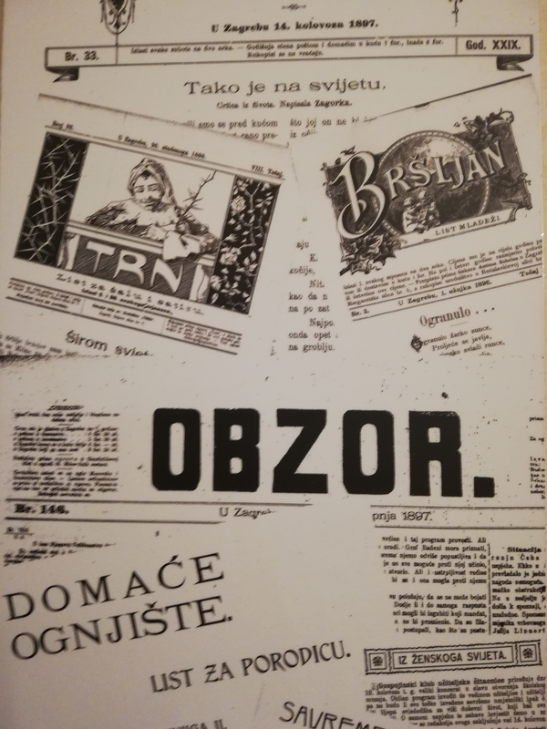
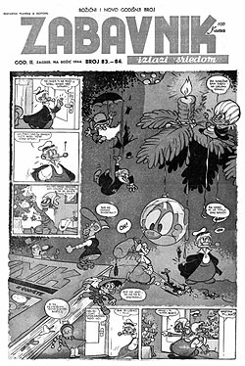
Posao
Nakon rastave braka Zagorka se vratila u Hrvatsku pa je kao nepotpisana autorica počela raditi na uređivanju časopisa “Hrvatski branik” i “Posavska Hrvatska”. Krajem iste te godine postala je članicom redakcije “Obzora”.
U Obzoru je objavljivala razne feljtone, novele i humoreske, kao i biografske crtice te autobiografske bilješke.
U doba narodnog pokreta Zagorka je poslana u Budimpeštu da šalje izvješća o radu hrvatsko-ugarskog sabora.
Nedugo nakon povratka u Zagreb pokrenula je ilustrirane tjedne novine “Zabavnik”,te započela suradnju s Jutarnjim listom pišući društvene i kriminalističke reportaže.

Slide 4

Prvi hrvatski kriminalistički roman
U romantizmu kriminalističke su priče postale sastavni dio svjetske književnosti te je hrvatska književnost potvrdila ovaj žanr zahvaljujući Mariji Jurić Zagorki i njenom djelu “Kneginja iz Petrinjske ulice“.

Slide 5



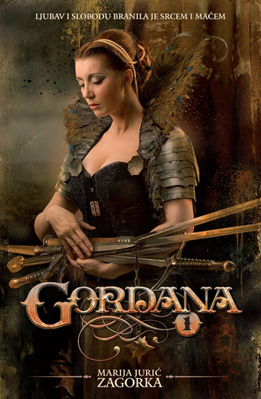


Poznata djela
Grička vještica
Kamen na cesti
Republikanci
Gordana
Mala revolucionarka
Plameni inkvizitori

Slide 6
Literatura
https://www.google.com/url?sa=i&url=https%3A%2F%2Fzagorkinkutak.wordpress.com%2Fdjela%2Fplameni-inkvizitori%2F&psig=AOvVaw2k7l-cTZvjIf6Mu_rgwX5o&ust=1678288226908000&source=images&cd=vfe&ved=0CA0QjRxqFwoTCPj8jv-Myv0CFQAAAAAdAAAAABAD
https://www.google.com/url?sa=i&url=https%3A%2F%2Fwww.goodreads.com%2Fbook%2Fshow%2F22852559-mala-revolucionarka-roblje&psig=AOvVaw1Tqk3CSVdCsDFRmnpcAhpv&ust=1678288193578000&source=images&cd=vfe&ved=0CA0QjRxqFwoTCJj2oe-Myv0CFQAAAAAdAAAAABAD
https://www.google.com/url?sa=i&url=https%3A%2F%2Feknjizara.hr%2Fartikli%2Fgordana-1%2F&psig=AOvVaw3panJFtlCBhArF5oFuhA7P&ust=1678288157745000&source=images&cd=vfe&ved=0CA0QjRxqFwoTCPiujt6Myv0CFQAAAAAdAAAAABAR
https://www.google.com/url?sa=i&url=https%3A%2F%2Fwww.hocuknjigu.hr%2Fproizvodi%2Fknjige%2Fknjizevnost%2Fdrama%2Frepublikanci&psig=AOvVaw0-keW2LNiasiLmbrmg3m2g&ust=1678288125948000&source=images&cd=vfe&ved=0CA0QjRxqFwoTCKCv_86Myv0CFQAAAAAdAAAAABAD
https://www.google.com/url?sa=i&url=https%3A%2F%2Fwww.hocuknjigu.hr%2Fproizvodi%2Fknjige%2Fknjizevnost%2Fdrama%2Fkamen-na-cesti&psig=AOvVaw3Mge_jNSAyMM7SvvU5w3eq&ust=1678288095093000&source=images&cd=vfe&ved=0CA0QjRxqFwoTCJC9t8CMyv0CFQAAAAAdAAAAABAD
https://www.google.com/url?sa=i&url=http%3A%2F%2Fnsk.hr%2Fblog%2Frazmisljanja-citanje-hrvatskog-bestselera-gricka-vjestica-marije-juric-zagorke%2F&psig=AOvVaw3dYsf5ANNAQ3MLny-BiA6W&ust=1678288058639000&source=images&cd=vfe&ved=0CA0QjRxqFwoTCJDin7aMyv0CFQAAAAAdAAAAABAD
https://www.najboljeknjige.com/autor/marija-juric-zagorka
https://lektire.skole.hr/zanimljivosti/sjecanje-na-mariju-juric-zagorku/
https://www.google.com/url?sa=i&url=https%3A%2F%2Ficz.hr%2F2021%2F03%2F02%2Fna-danasnji-dan-rodena-je-marija-juric-zagorka-jeste-li-znali-da-je-dio-svog-djetinjstva-provela-u-dvorcu-luznica%2F&psig=AOvVaw3129jhbJJo4y0CXit8Uckt&ust=1678288492286000&source=images&cd=vfe&ved=0CA0QjRxqFwoTCPDt9IGOyv0CFQAAAAAdAAAAABAc
https://www.google.com/url?sa=i&url=https%3A%2F%2Fshe.hr%2Fna-danasnji-dan-umrla-je-marija-juric-zagorka%2F&psig=AOvVaw3129jhbJJo4y0CXit8Uckt&ust=1678288492286000&source=images&cd=vfe&ved=0CA0QjRxqFwoTCPDt9IGOyv0CFQAAAAAdAAAAABAl
https://www.google.com/imgres?imgurl=http%3A%2F%2Fzagorka.net%2Fwp-content%2Fuploads%2F2020%2F05%2FNovine72.jpg&imgrefurl=http%3A%2F%2Fzagorka.net%2Fnasa-zagorka-borkinja-za-rodnu-i-politicku-ravnopravnost%2F&tbnid=2uFlsaZ9MHUoWM&vet=12ahUKEwiCzY2ojsr9AhXiWOUKHbjyB4IQMygDegUIARCrAQ..i&docid=sHTD9XIb2C3YtM&w=600&h=800&q=obzor%20marija%20juric%20zagorka&ved=2ahUKEwiCzY2ojsr9AhXiWOUKHbjyB4IQMygDegUIARCrAQ
https://www.google.com/url?sa=i&url=http%3A%2F%2Fwww.stripforum.hr%2Fleksikon%2Fmagazin%2Fzabavnik-1943-1945-44%2F&psig=AOvVaw2C1rxg521aBQHyIFSDiumj&ust=1678288617132000&source=images&cd=vfe&ved=0CA0QjRxqFwoTCOiShLqOyv0CFQAAAAAdAAAAABAI
https://www.google.com/url?sa=i&url=https%3A%2F%2Fzagorkinkutak.wordpress.com%2Fdjela%2Fkneginja-iz-petrinjske-ulice%2F&psig=AOvVaw0cMiLJSHp0nDOXlYotMLPz&ust=1678288653700000&source=images&cd=vfe&ved=0CA0QjRxqFwoTCLDv1MqOyv0CFQAAAAAdAAAAABAD

