Slide 1
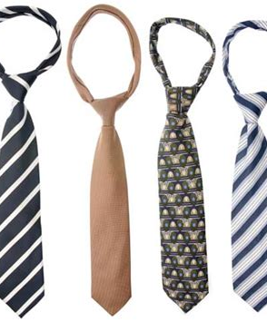
The Tie
-Petar Bičanić, Klara Grgurovac, Katarina Ilić I Karlo Matanović

Slide 2

What is a tie?
A tie is a piece of cloth worn for decorative purposes around the neck
It rests under the shirt collar and is knotted at the throat
And often draped down the chest.

Slide 3
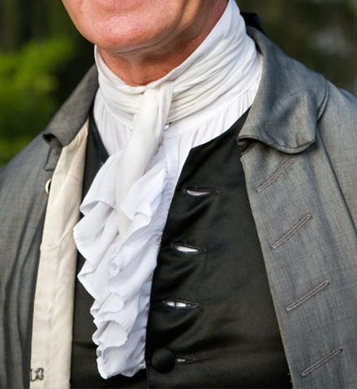
History of the tie

Slide 4
The necktie in Chinese history
In 1974 a tomb of the 1st Emperor of China was discovered
Qin Shih Huang, initially intended to have his army accompany him in the afterlife as protectors.
Fortunately, his advisors persuaded him to opt for life-sized replicas of his troops.
In 210 BC, upon his death, This terracotta "army" was buried in this manner..
Each figurine wore a wrapped neck cloth, marking an early precursor to the modern necktie.
It appears that Qin Shih Huang's army was the sole group of Chinese individuals known to wear such neck cloths.
  No depictions of Chinese soldiers or the general populace wearing this garment from that era have ever surfaced.
Historians speculate that these neckties may have served as a symbol of honor for Qin Shih Huang's army.

Slide 5
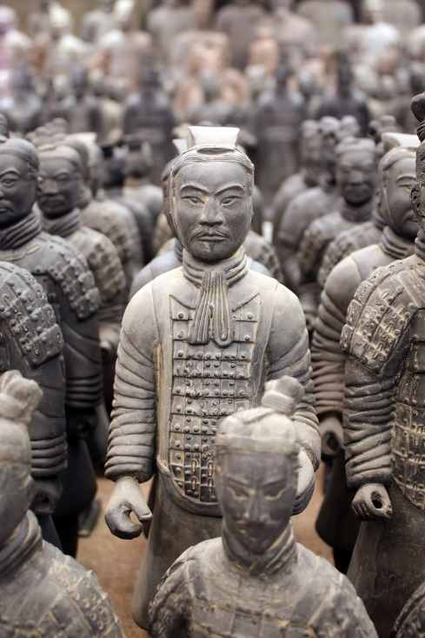
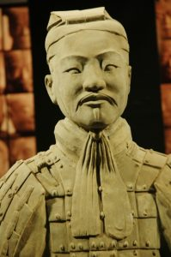

Slide 6
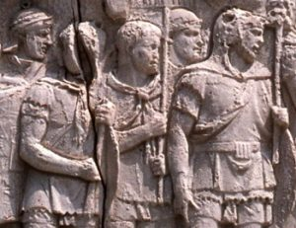
Ancient Rome
Necktie depicted in Trajan's Column in Rome, Italy, during Emperor Trajan's rule from 98 to 117 AD.
Trajan's marble column, built around 113 AD, showcases soldiers wearing various neckwear styles.
Similar to the Chinese case, no records of other Roman soldiers wearing neckties exist from this period.
Neckties on Roman soldiers may have symbolized honor for exceptional fighters.
Chinese use of neckwear predates Roman legions by over 300 years, proving the idea that Romans were the first to wear cravats false.

Slide 7
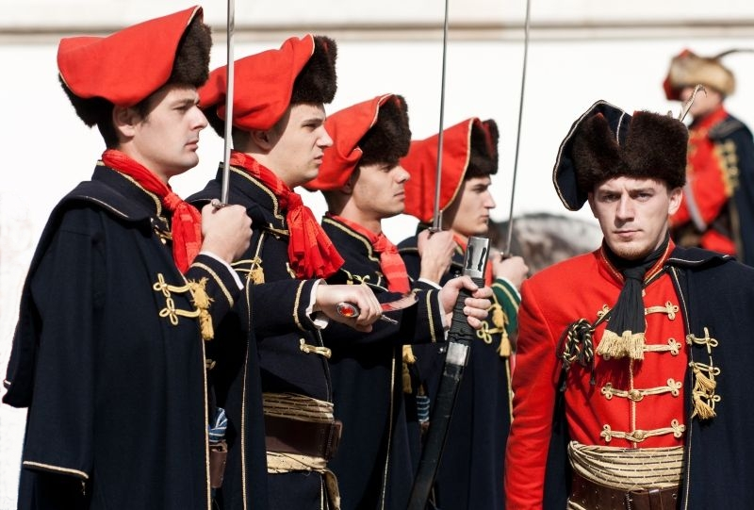
Croatian origins
The cravat has its roots in Croatian mercenaries who served in France during the Thirty Years' War (1618-1648).
These soldiers wore small, knotted neckerchiefs from their homeland, which intrigued the people of Paris.
The word "cravat" came about due to a linguistic difference between the Croatian and French terms for Croats.
Louis XIV, a young French king, popularized this fashion by wearing a lace cravat in 1646, setting a trend for the nobility.
This led to a fashion craze in Europe, where both men and women started wearing neck accessories.

Slide 8
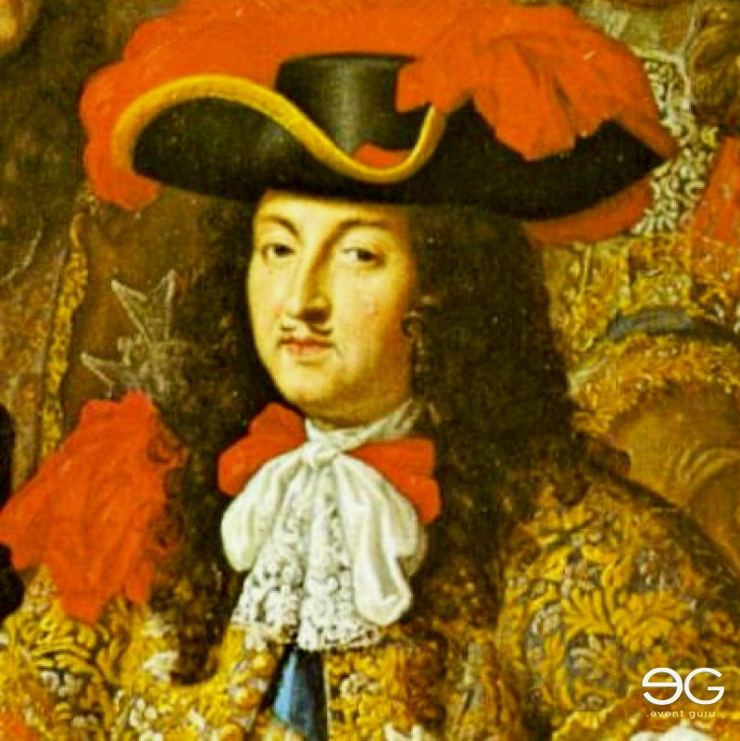
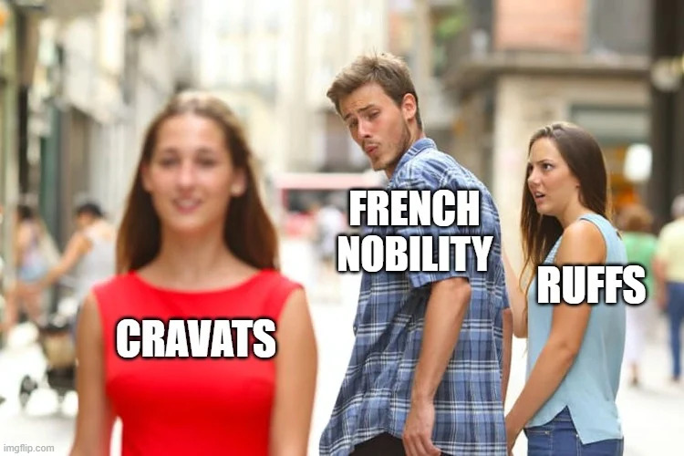
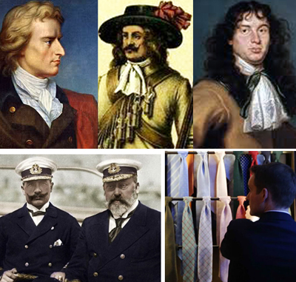

Slide 9
Evolution and Timeline
210 BC
China
Qin Shih Huang was buried with teraccota soldiers that wore scarves
Late 17th century
Louis XIV popularizes the cravat, setting a trend for French nobility.
18th century
Neckwear becomes more elaborate, transitioning from simple neckerchiefs to ornate lace cravats favored by European nobility.
19th century
The modern necktie takes shape, characterized by long, narrow ties in various knots, fabrics, and patterns, reflecting changing fashions.
today
The necktie is a symbol of formality and status, that evolved into the iconic accessory we know today.
Necktie depicted in Trajan's Column in Rome, Italy, during Emperor Trajan's rule.
117AD
Ancient Rome
The cravat, or necktie, originates with Croatian mercenaries serving in France during the Thirty Years' War.
17th century

Slide 10
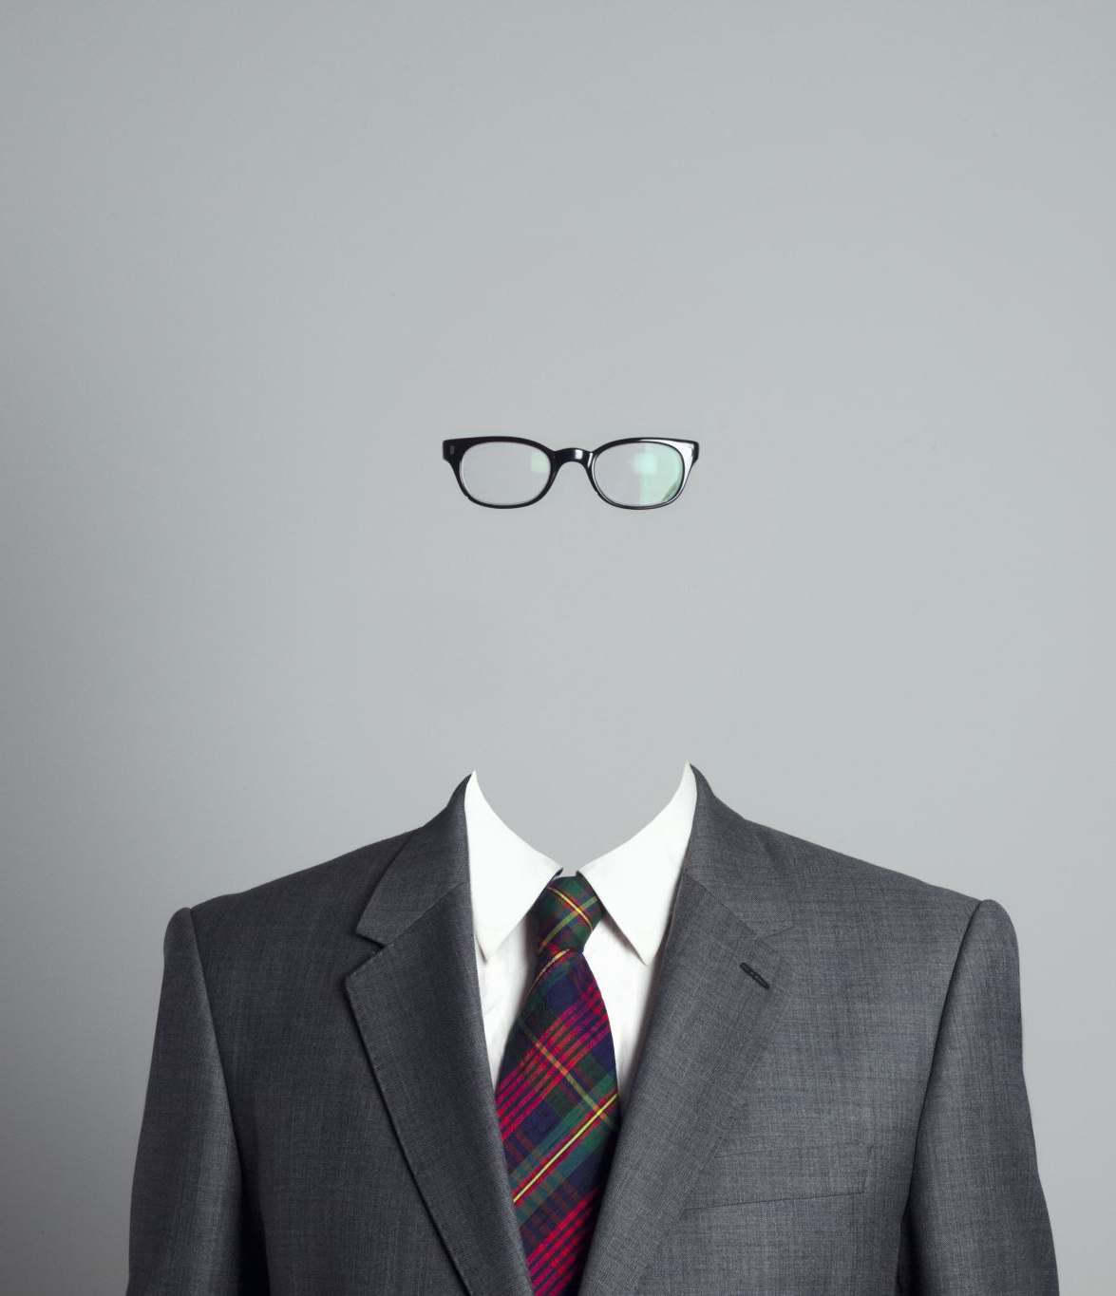
20th century
The early twentieth century witnessed the rise of clerical work and the proliferation of white-collar jobs.
During this era, the necktie transformed into a symbol representing one's occupation and social status.
Wearing a necktie marked a transition from blue-collar labor to white-collar positions, symbolizing a shift in the social hierarchy.
The necktie became a visible indicator that wearers had moved into roles involving intellectual and administrative tasks, distinguishing them from their blue-collar counterparts.

Slide 11
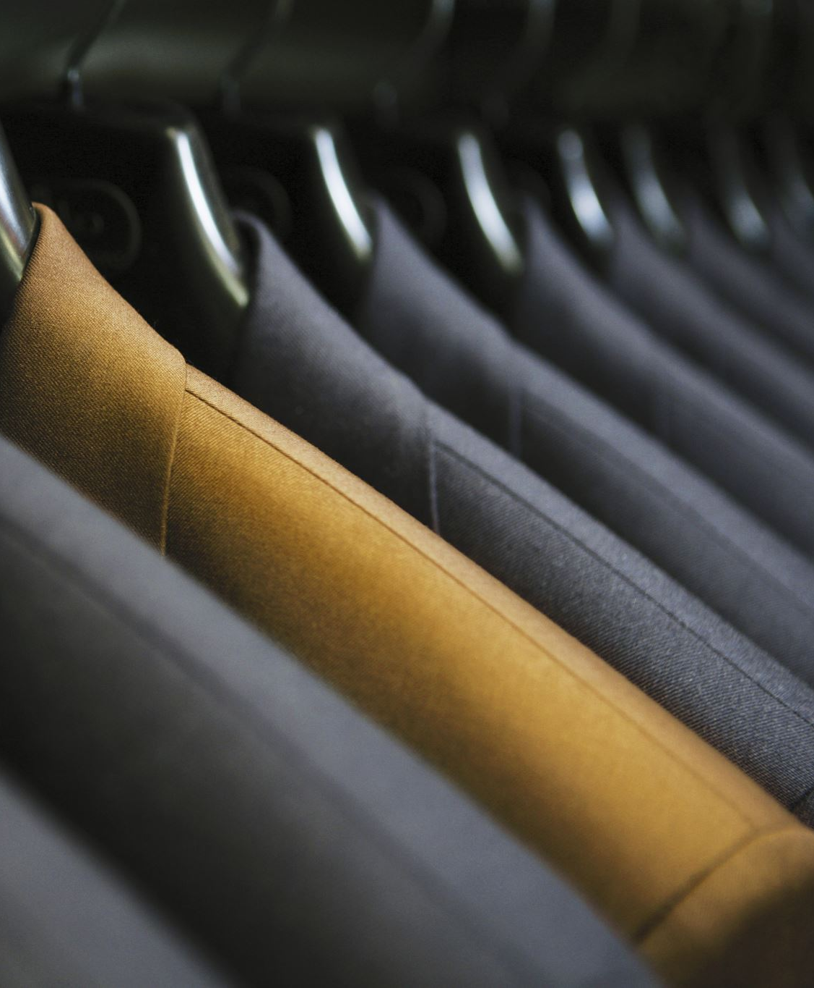
Ties are often used for:
Formal and semi-formal attire
Business and professional settings
Formal events
Weddings
School uniforms (in some cases)

Slide 12
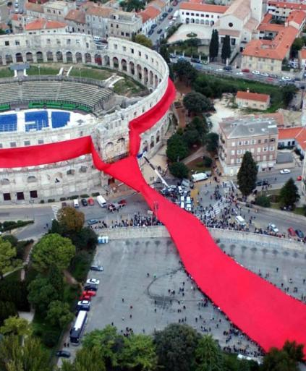
International necktie day
In 2008 Croatian Parliament decided that the “International Cravat Day” is to be celebrated on every October the 18th.
This fun holiday celebrates the ties rich history and role in men's fashion
The picture shows the worlds largest tie tied around the Roman amphitheater in Pula.

Slide 13
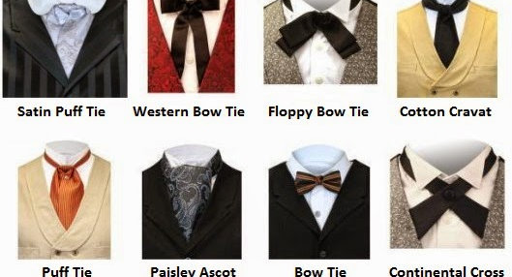
Types of ties

Slide 14
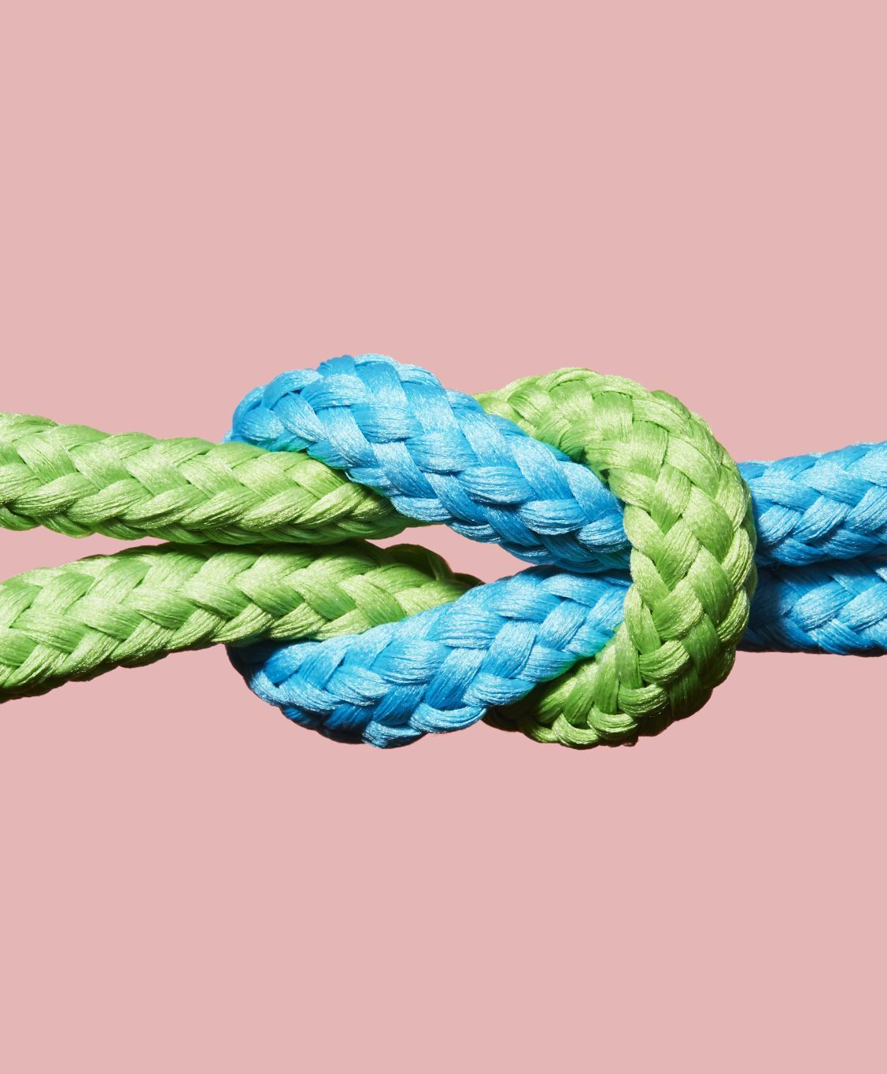
Types of tie knots
The four-in-hand knot, which is often considered the most common tie knot.
The Pratt knot, also known as the Shelby knot.
The half-Windsor knot.
The Windsor knot, which is sometimes redundantly referred to as the "full Windsor" or the "Double Windsor."
Small knot, the smallest possible knot
Nicky knot, very similar to the Pratt knot

Slide 15
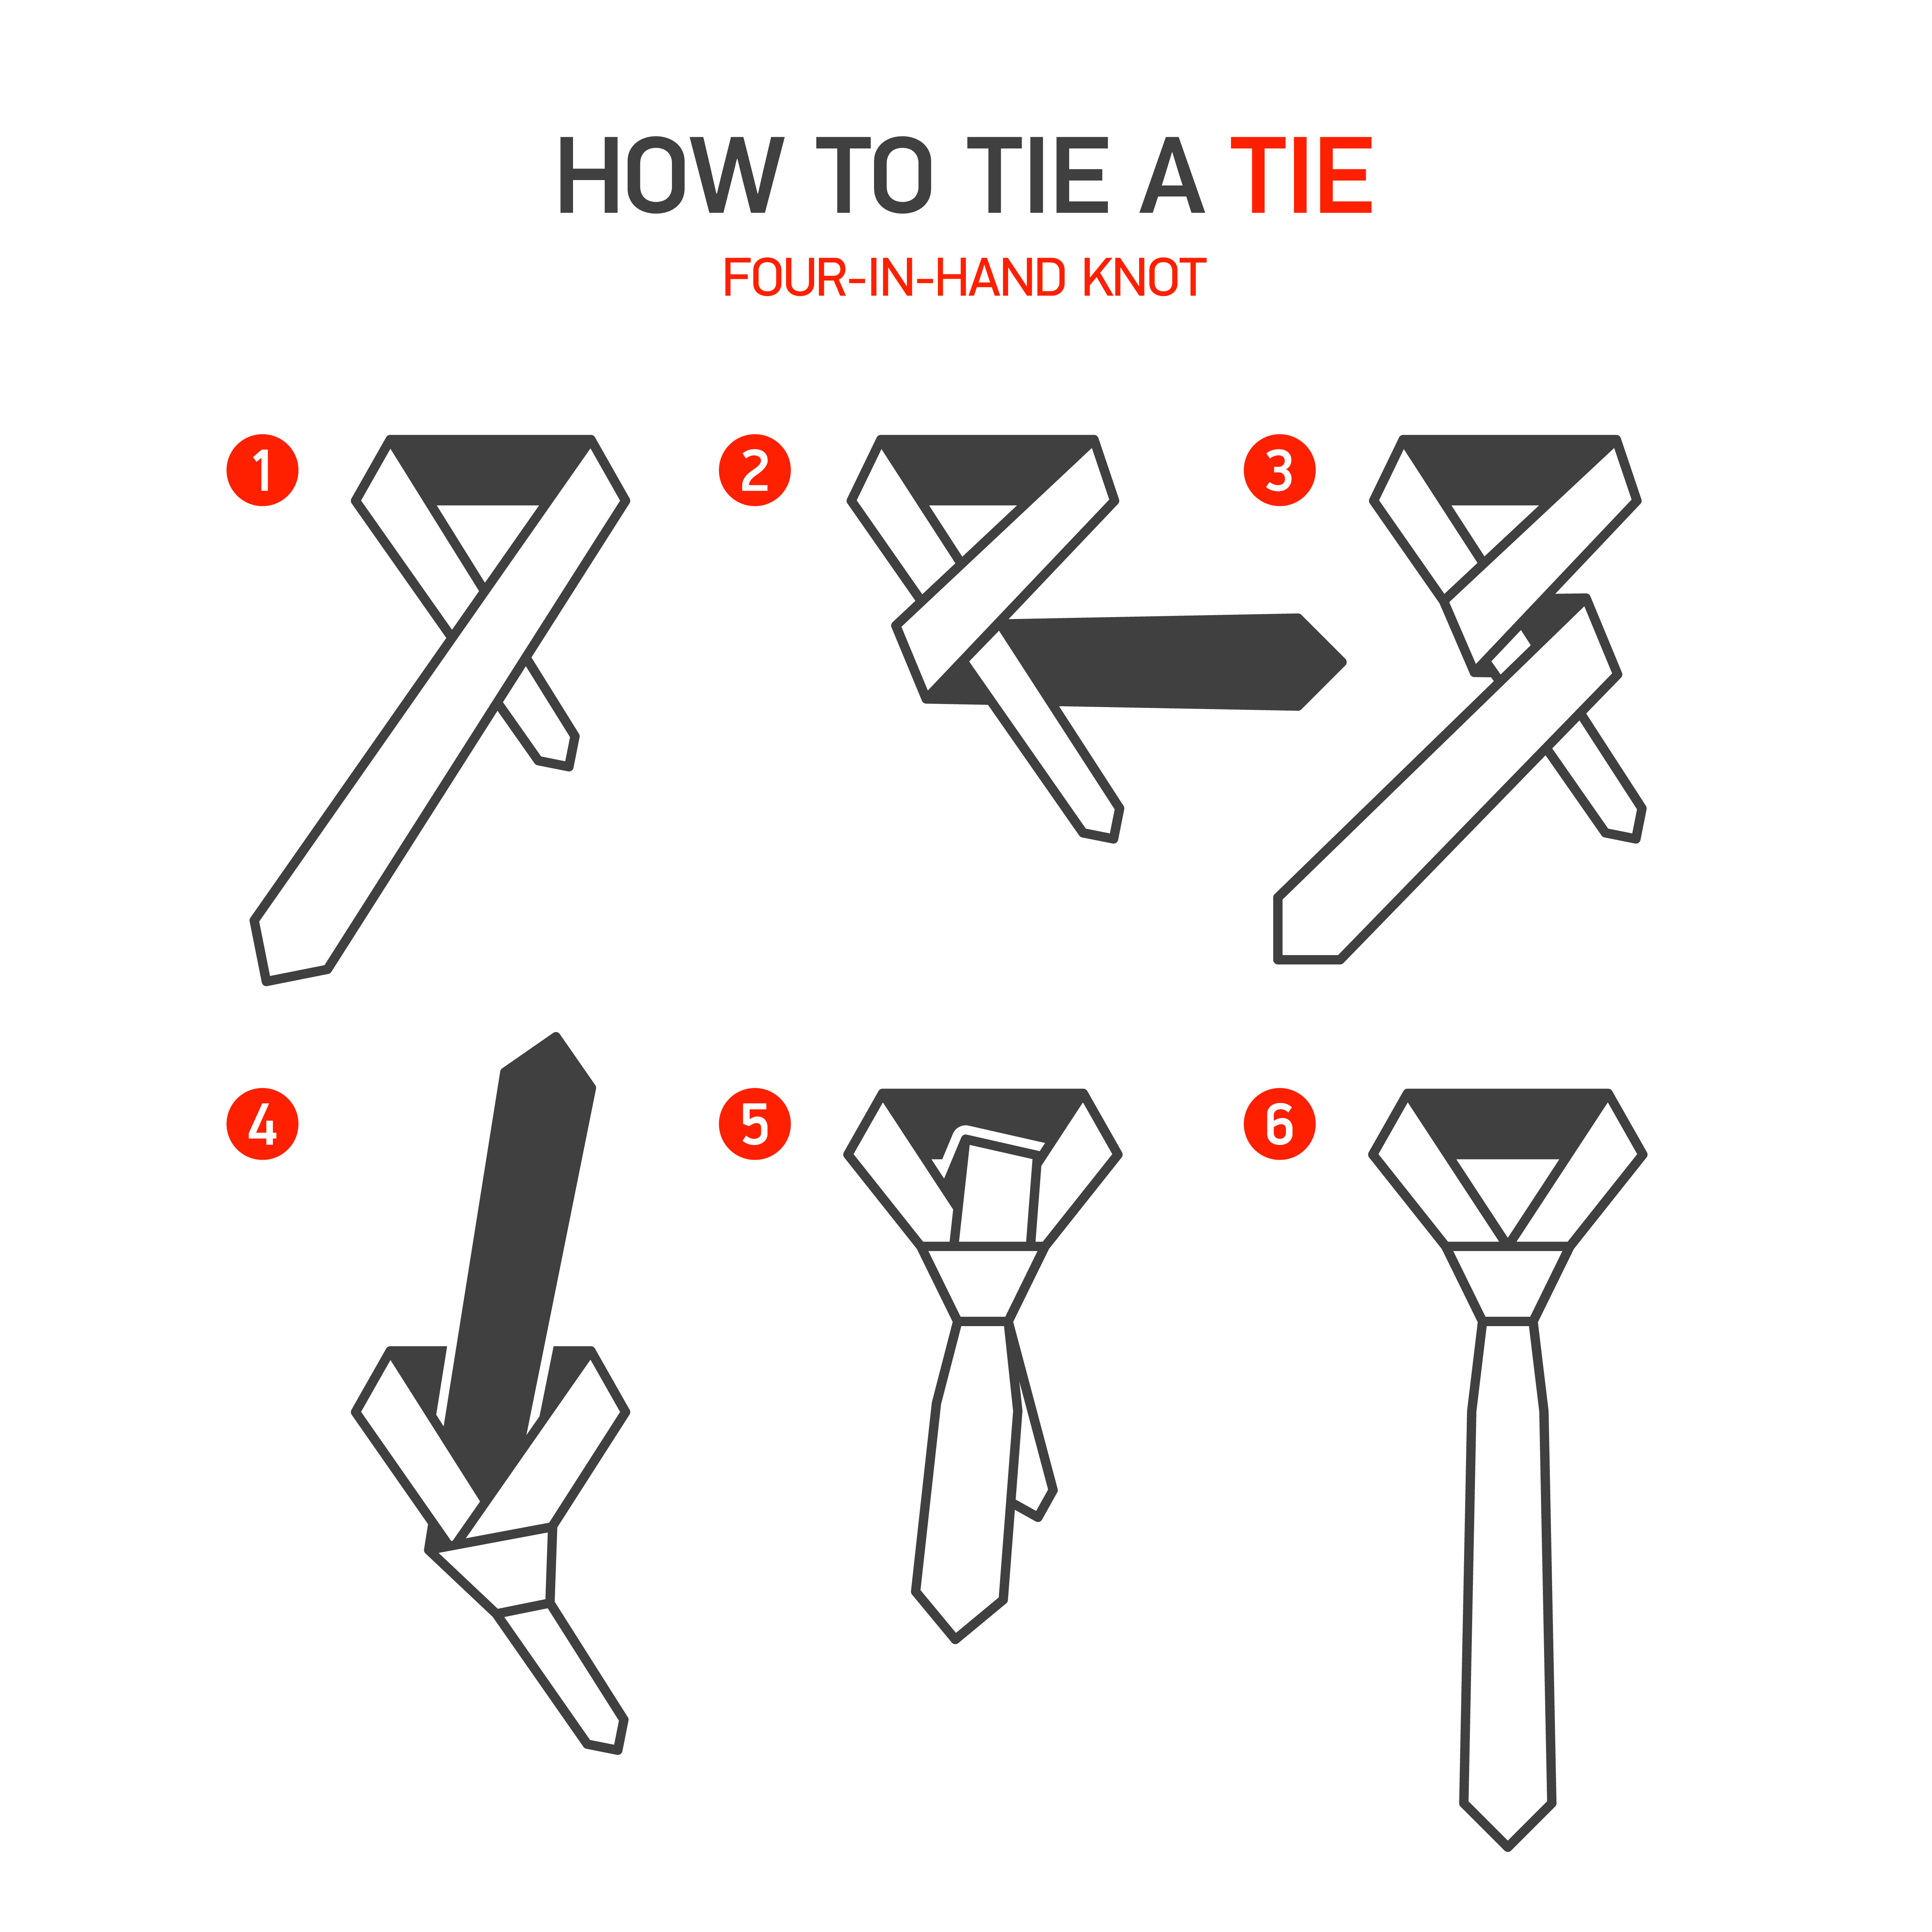
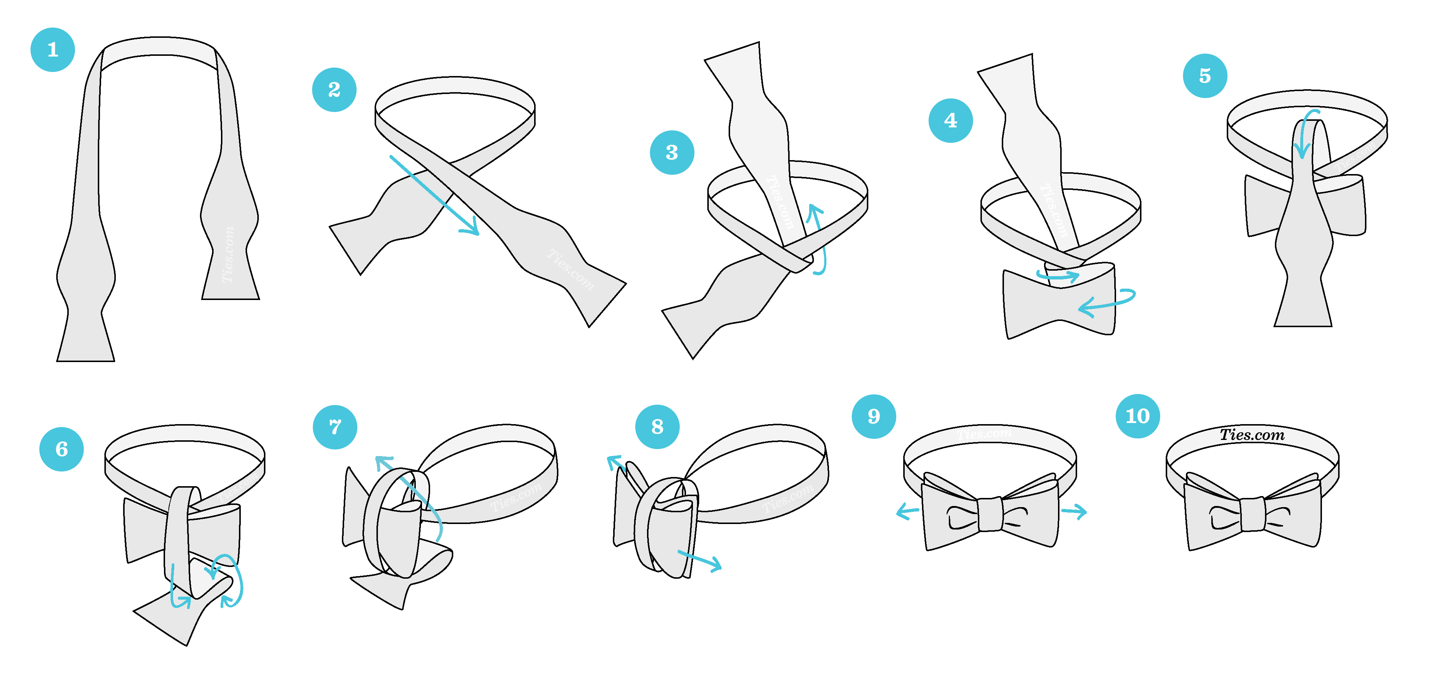
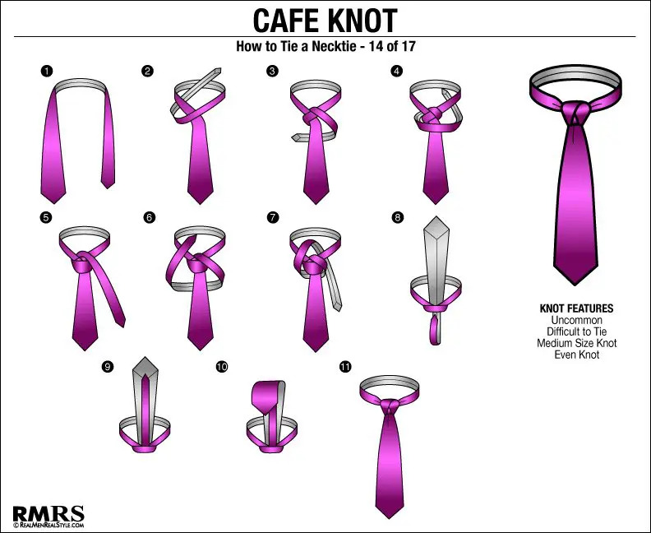
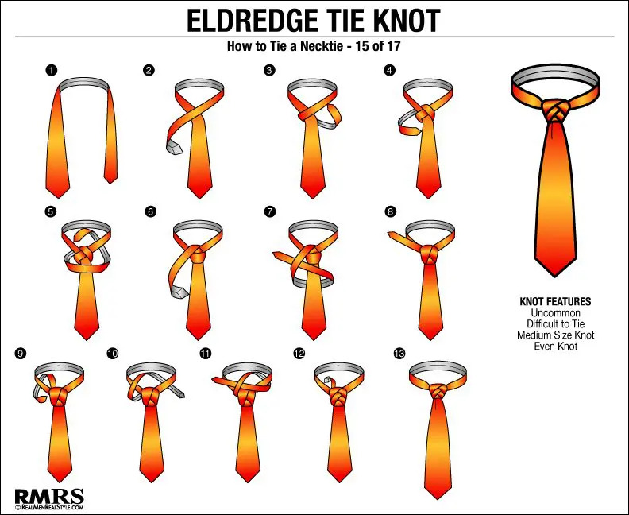
How to tie a tie?

Slide 16
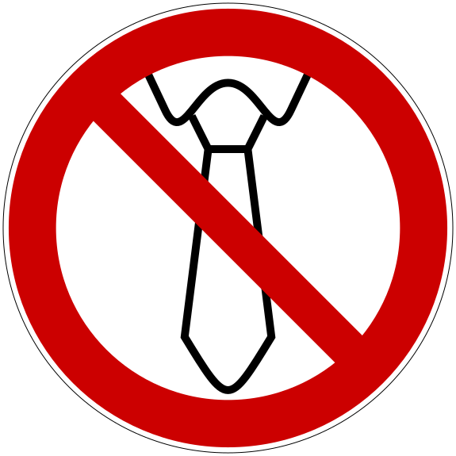
Health and safety hazards of neckties
Risk of entanglement, especially in workplaces with moving machinery, where a dangling tie can pose a significant danger.
Medical studies have shown that tightly knotted neckties may restrict blood flow to the brain and increase intraocular pressure, affecting individuals with weakened retinas or glaucoma.
Jobs with potential for violence, like police officers, prison guards, and some medical fields, face entanglement risks.
Neckties have been identified as potential vectors of disease transmission in healthcare settings, as they are less frequently cleaned than other clothing.
In the UK, police officers, traffic wardens, and security guards wear clip-on ties that quickly detach when pulled.
A symbol for not wearing a tie

Slide 17

Watch this video
https://youtu.be/o1t6py03K7s?si=-Xn4DoQA-Zbac4PH

Slide 18
Image sources
https://www.traditioninaction.org/Cultural/C044_Tie
https://www.custommadecufflinks.com/tie-history/
https://custommadecufflinks.com/wp-content/uploads/2018/08/Trajans-legionaries-History-of-Ties.jpg
https://www.todayifoundout.com/index.php/2013/03/the-origins-of-the-neck-tie/
https://fr.vikidia.org/wiki/Cravate
http://media.gettyimages.com/photos/portrait-of-louis-xiv-of-france-known-as-louis-the-great-or-the-sun-picture-id164086177?k=6&m=164086177&s=612x612&w=0&h=i58PC-0SgkEoB9kvlBqXY8ODXzL1M_HadktQMeFrA4I=
http://www.plitvicetimes.com/happy-cravat-day-know-modern-necktie-croatian-national-heritage/
https://www.timetoast.com/timelines/history-of-neckties

Slide 19
Image sources
http://www.wedresearch.net/2015/01/grooms-suit-attire.html
http://www.philly.com/philly/news/science/24882_ways_to_tie_your_necktie.html
https://channelsonline.nl/index.php/a-students-guide-to-tying-your-tie/
https://cranach-blog.blogspot.com/2021/07/tie-tie-easy-how-to-tie-bow-tie-step-by.htm
https://www.realmenrealstyle.com/how-to-tie-a-tie/l
https://en.wikipedia.org/wiki/File:DIN_4844-2_D-P027.svg
https://res.cloudinary.com/realcroatia/image/upload/w_770,h_513,c_fill,q_75/Blog_International_cravat_day_2_academia_cravatica_q3luta

Slide 20
Info sources
https://www.todayifoundout.com/index.php/2013/03/the-origins-of-the-neck-tie/
https://en.wikipedia.org/wiki/Necktie
https://custommadecufflinks.com/tie-history/
https://www.scienceabc.com/humans/why-do-people-wear-ties
https://www.realcroatia.com/en/blog/Croatia-international-cravat-necktie-day/

